Slide 1
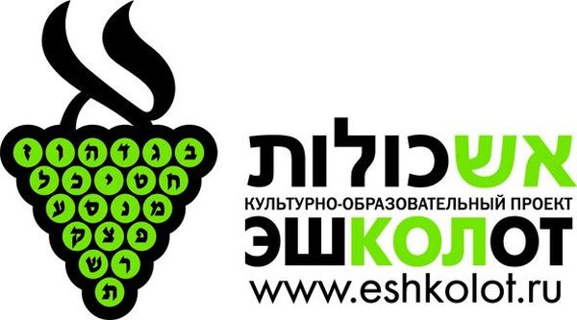
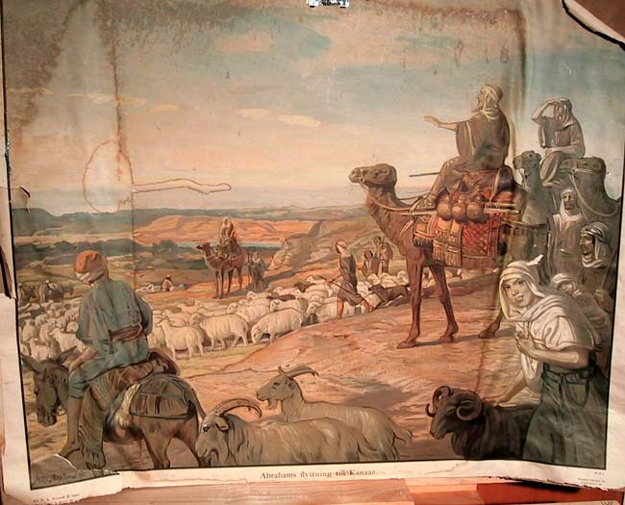
The Genesis of the Israeli Language
Ghil‘ad Zuckermann (Гилад Цукерман)
D.Phil. (Oxon.), Ph.D. (Cantab., titular)
Professor of Linguistics & Chair of Endangered Languages
The University of Adelaide, Australia
http://www.zuckermann.org ; ghilad.zuckermann@adelaide.edu.au
Moscow, 12-14 November 2018
Notes:
1

Slide 2
Professor Ghil‘ad Zuckermann 诸葛漫
D.Phil. (Oxon.)
Chair of Linguistics of Endangered Languages, The University of Adelaide
ghilad.zuckermann@adelaide.edu.au
http://www.adelaide.edu.au/directory/ghilad.zuckermann
http://www.facebook.com/ProfessorZuckermann
Professor Ghil‘ad Zuckermann

Slide 3
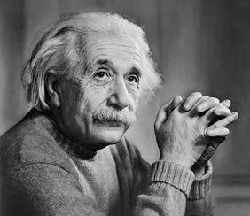

Seven Jews have changed the world:
1. Moses
2. Jesus
3. Marx
4. Freud
5. Zuckermann ;-)
6. Zuckerberg
7. Einstein

Slide 4
The Success of Language Reclamation is Relative
  The success of language revival is relative.
  (No language reclamation can be fully successful.)
  ‘Not that there’s anything wrong with that!’
  (Jerry Seinfeld)
Professor Ghil‘ad Zuckermann

Slide 5
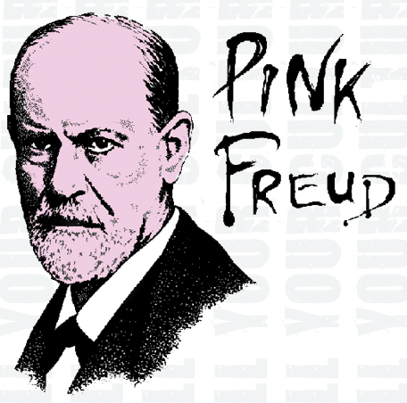

Slide 6
The Hebrew Revival
Professor Ghil‘ad Zuckermann

Slide 7
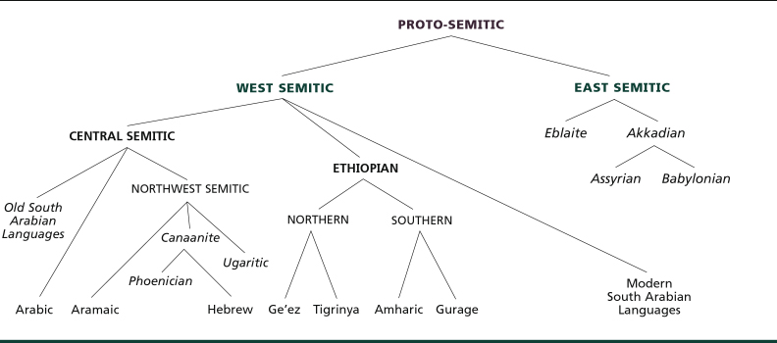
CHART OF THE SEMITIC FAMILY TREE Afro-Asiatic
Israeli
Professor Ghil‘ad Zuckermann

Slide 8
SOCIOLINGUISTIC BACKGROUND
‘Hebrew’ is one of the 1+0.5+0.5 official languages of the State of Israel (established in 1948) (Egnlish and Arabic being de facto but not de jure) and is spoken to varying degrees of fluency by its 9 million citizens – as a mother tongue by most Jews (whose total number exceeds 6 million), and as a second language by Muslims (Arabic-speakers), Christians (e.g. Russian- and Arabic-speakers), Druze (Arabic-speakers) and others.
During the past century, Israeli, somewhat misleadingly a.k.a. ‘Modern Hebrew’, has become the primary mode of communication in all domains of public and private life.
Yet, with the growing diversification of Israeli society, it has come also to highlight the very absence of a unitary civic culture among citizens who seem increasingly to share only their language.
Professor Ghil‘ad Zuckermann

Slide 9
Issues of language are so sensitive in Israel that politicians are often involved.
In a session at the Israeli Parliament on 4 January 2005, then Prime Minister Ariel Sharon rebuked Israelis for using the etymologically Arabo-English hybrid expression yàla báy, lit. ‘let’s bye’, i.e. ‘goodbye’, instead of ‘the most beautiful word’ shalóm ‘peace, hello, goodbye’.
In an article in the daily newspaper Ha’aretz (21 June 2004), the left-wing politician Yossi Sarid attacked the common language of éser shékel (‘ten shekels’, rather than asar-á shkal-ím ‘ten-f shekel-mpl’, the latter having a polarity-of-gender agreement – with a feminine numeral and a masculine plural noun) as inarticulate and monstrous, and urged civilians to fight it and protect ‘Hebrew’.
Professor Ghil‘ad Zuckermann

Slide 10
One could see in these rebukes the common nostalgia of a conservative older generation unhappy with ‘reckless’ changes to the language – cf. Aitchison (2001) and Hill (1998).
But normativism in Israeli contradicts the usual ‘do not split your infinitives’ model, where there is an attempt to enforce the grammar and pronunciation of an elite social group.
Using a ‘do as I say, don’t do as I do’ approach, Ashkenazic Jews (most of them originally native Yiddish-speakers), who have usually controlled key positions in Israeli society, have urged Israelis to adopt the pronunciation of Sephardic Jews (many of them originally native Arabic-speakers), who happen to have been socio-economically disadvantaged.
In fact, politicians, educators and many laymen are attempting to impose Hebrew grammar on Israeli speech, ignoring the fact that Israeli has its own grammar, which is very different from that of Hebrew.
Professor Ghil‘ad Zuckermann

Slide 11
THE ORIGINS OF
REVIVED HEBREW
Professor Ghil‘ad Zuckermann

Slide 12
One of the most fundamental questions about Israeli concerns the way it emerged. The answer to this question depends inter alia on which language constituent(s) the linguist considers most important in determining the genetic classification of a language.
By ‘language constituents’ I refer especially to morphology, basic vocabulary, syntax and phonology.
However, not only linguistic considerations apply. There are also extra-linguistic elements, such as the history of the language and its speakers.
Professor Ghil‘ad Zuckermann

Slide 13
It is hard to refute that
(i) Hebrew suffered from severe lexical and other paucities;
(ii) Due to the cosmopolitan nature of Israeli society, the Israeli language emerged under the influence of Yiddish, as well as other languages from different language families;
(iii) The emergence of Israeli was ideologically supported in order to strengthen the Jewish settlement in Eretz Yisrael (cf. Naphtali Herz Tur-Sinai 1960: 9 and Wexler 1990: 13).
However, the question still remains whether Israeli is the legendary phoenix, rising triumphant from the ashes (i.e. revival), or whether it is like the common cuckoo who lays its eggs in the nest of another bird (Yiddish), tricking it into the role of foster parent at the expense of the original offspring (i.e. usurpation).
One might ask, like the biblical Jehovah after the stoning of Naboth, haratsákhta vegám yaráshta? ‘Hast thou killed and also taken possession?’ Or does Israeli have the ‘hybrid vigour’ of a ‘phoenicuckoo cross’ (i.e. hybridization)?
Professor Ghil‘ad Zuckermann

Slide 14
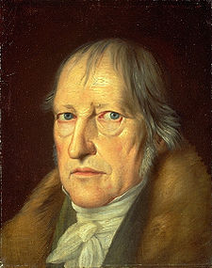
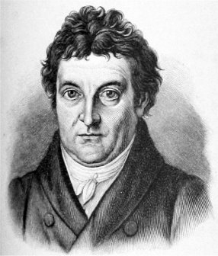
Hegelian Dialectic
(Georg Wilhelm Friedrich Hegel →→)
(actually Johann Gottlieb Fichte’s
←←)
THESIS –
ANTITHESIS –
SYNTHESIS
Generally speaking:
USA, beginning of the 20th Century:
Classical Music (folk too) – Blues – Pop/Rock
Professor Ghil‘ad Zuckermann

Slide 15
HEBREW?
Professor Ghil‘ad Zuckermann

Slide 16
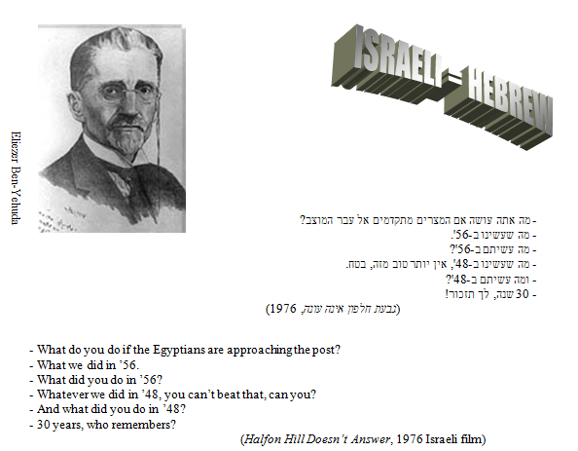
THESIS: THE TRADITIONAL VIEW: ISRAELI IS SEMITIC: REVIVAL
Israeli is (Biblical/Mishnaic) Hebrew (miraculously) revived.
Professor Ghil‘ad Zuckermann

Slide 17
In any linguistic lecture one ought to mention Chomsky
Professor Ghil‘ad Zuckermann

Slide 18
Zeev William Chomsky (1957: 218), Hebrew – The Eternal Language (Philadelphia: The Jewish Publication Society of America):
It may be safely assumed that there were always somewhere in the world, especially in Eretz Yisrael, individuals or even groups, who could and did employ the Hebrew language effectively in oral usage.
(*William Chomsky is Noam Chomsky’s father.)
Chomsky is misleading:
It is true that, throughout its literary history, Hebrew was used as an occasional lingua franca.
However, between the second and nineteenth centuries it was no one’s mother tongue. The development of a literary language is very different from that of a fully-fledged native language.
Professor Ghil‘ad Zuckermann

Slide 19
YIDDISH?
Professor Ghil‘ad Zuckermann

Slide 20
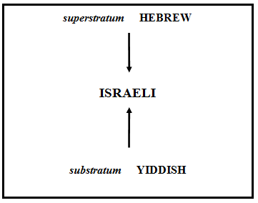
ANTITHESIS: THE REVISIONIST SCHOOL – ‘THE NEW (HISTORICAL) LINGUISTS’: ISRAELI IS INDO-EUROPEAN: RELEXIFICATION
ein Hebräisch, das in Wirklichkeit eine europäische Sprache in durchsichtiger hebräischer Verkleidung ist, mit gemeineuropäischen Zügen und einzelsprachlichen Besonderheiten, aber nur ganz äußerlich hebräischem Character.
(Gotthelf Bergstra_sser 1928: 47, Einführung in die semitischen Sprachen: Sprachproben und Grammatische Skizzen, Ismaning: Max Hueber)
HEBREW
K. Katzenelson (1960: 39) (setting aside his problematic social views):
לשון הבסיס [...] היא יידיש ו [...] עברית היא [...] שׂפת עזר שכל המתבטא בה מוקרן אליה מן היידיש
ISRAELI
YIDDISH
Professor Ghil‘ad Zuckermann

Slide 21
The base language is Yiddish and Hebrew is a language of assistance with all that is expressed in it projected from Yiddish.
Katzenelson (1960: 65):
אנו מדברים יידיש, רוסית, ערבית ואנגלית במלים עבריות. ומאחר שמכל הלשונות שבפה היהודי יידיש היא האדירה ביותר הרי היא מטביעה את חותמה על דיבורנו העברי וקובעת לו צורה אחידה. הצלחתה של העברית המדוברת אינה הצלחתה שלה אלא הצלחתה של היידיש שבאיזה שהוא אופן השתלטה עליה ושעבדה אותה, כשם שהיהודים דוברי היידיש השתלטו על כל שאר היהודים של המדינה והכניסו אותם למסגרות השונות שיצרו.
We speak Yiddish, Russian, Arabic and English – in Hebrew words. And since of all the tongues spoken by the Jew Yiddish is the greatest, it leaves its trace on our Hebrew speech and determines a uniform form for it. The success of spoken Hebrew is not its own success but rather the success of Yiddish, which in some way took control over it and enslaved it, much as the Yiddish-speaking Jews took control of all the other Jews of the State and put them into the various frameworks that they have created.
Professor Ghil‘ad Zuckermann

Slide 22
Plessner (1925: 684) suggests that as a result of the great extent of European influence, Hebrew (in becoming Israeli) underwent Entsemitisierung ‘deSemiticization’.
Wexler (cf. 1981: 107; 1990; Horvath and Wexler 1994, 1997) suggests that Israeli is Slavonic and is a result of a partial language shift from Yiddish (which he regards as Slavonic). In their 1997 monograph, Relexification in Creole and Non-Creole Languages, Horvath and Wexler propose that Israeli is the result of relexification.
Professor Ghil‘ad Zuckermann

Slide 23
ISRAELI?
Professor Ghil‘ad Zuckermann

Slide 24
SYNTHESIS: ZUCKERMANN’S MODEL:
ISRAELI IS BOTH SEMITIC AND INDO-EUROPEAN: HYBRIDIZATION
ISRAELI
YIDDISH
HEBREW
Professor Ghil‘ad Zuckermann

Slide 25
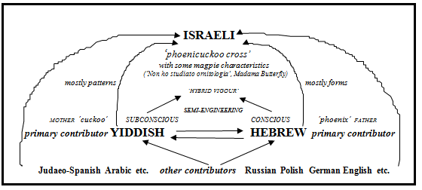
ZUCKERMANN’S HYBRIDIC MODEL
Professor Ghil‘ad Zuckermann

Slide 26

As opposed to the thesis and antithesis, which are mono-parental (see Peter Auer’s rejection of dual ancestry),
my own multi-parental synthesis acknowledges the historical and linguistic continuity of both Semitic and Indo-European languages within Israeli.

Slide 27
‘Genetically modified’, semi-engineered, layered Israeli is based simultaneously on Hebrew and Yiddish (both being primary contributors),
accompanied by a plethora of other contributors such as Russian, Polish, German, Judeo-Spanish (‘Ladino’) Arabic and English.
Therefore, the term ‘Israeli’ is far more appropriate than ‘Israeli Hebrew’, let alone ‘Modern Hebrew’ or ‘Hebrew’ (tout court).

Slide 28
Although they have engaged in a campaign for linguistic purity, the language the revivalists ‘created’ often mirrors the very cultural differences they sought to erase (cf. mutatis mutandis Frankenstein’s monster). The alleged victory of Hebrew over Yiddish was, in fact, a Pyrrhic one. Victorious Hebrew is, after all, partly European at heart. Yiddish and Standard Average European survive beneath ‘osmotic’ Israeli grammar.

Slide 29
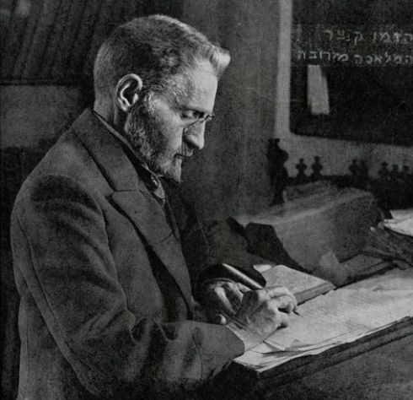
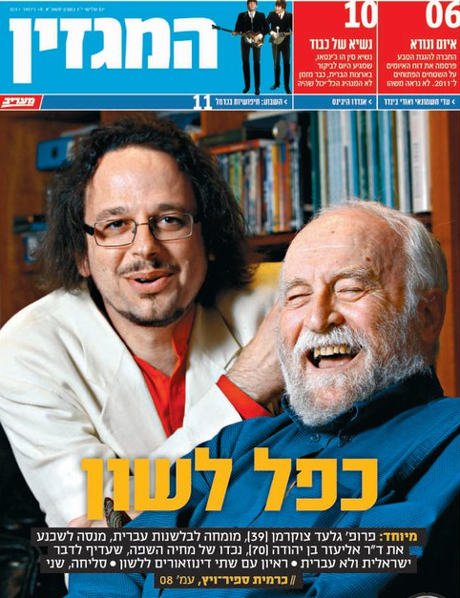
Eliezer Ben-Yehuda,
the main Hebrew revivalist
Eliezer Ben-Yehuda
the grandson
Professor Ghil‘ad Zuckermann

Slide 30
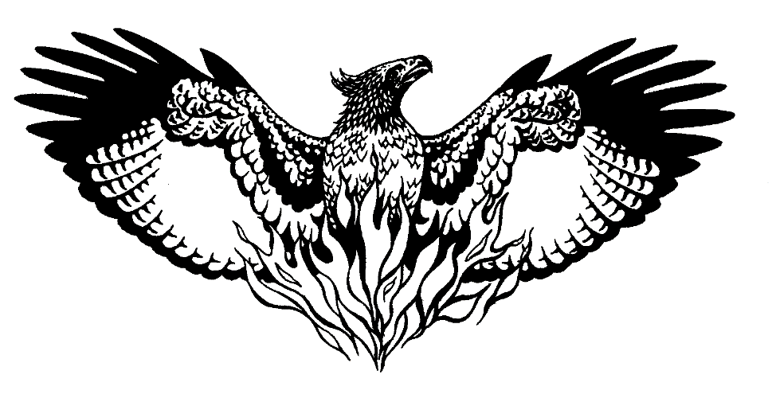
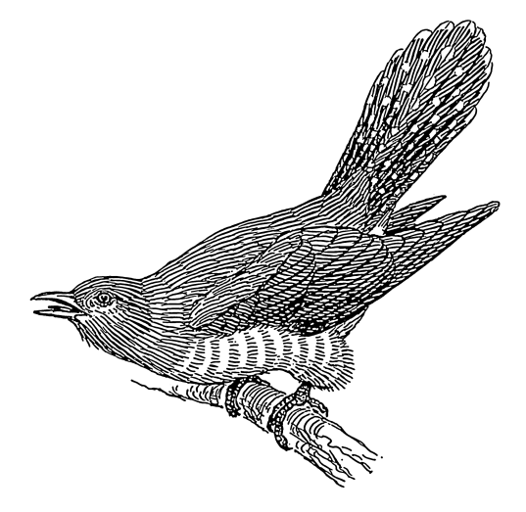
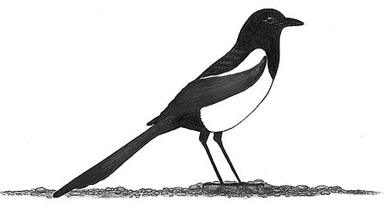
In reality, Revived Hebrew is a hybrid language!
Hybrid Vigour / Non ho studiato ornitologia!
A pheonicuckoo cross with some magpie characteristics
Phoenix
Cuckoo
Magpie
Professor Ghil‘ad Zuckermann

Slide 31
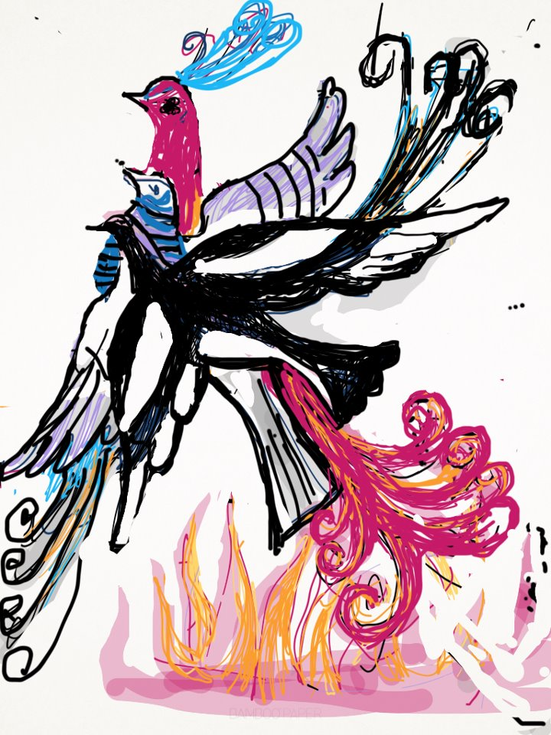
A reclaimed language as a pheonicuckoo cross with some magpie characteristics
Professor Ghil‘ad Zuckermann

Slide 32

Professor Ghil‘ad Zuckermann
Professor Ghil‘ad Zuckermann

Slide 33
Recommended video clip about the Hebrew revival
Google ‘Fry Zuckermann Vimeo’
British actor Stephen Fry interviewing Prof. Ghil‘ad Zuckermann
(BBC, 7.5 minutes)
http://vimeo.com/channels/357807/44019045
Professor Ghil‘ad Zuckermann

Slide 34
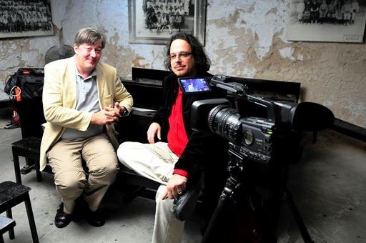
Professor Ghil‘ad Zuckermann

Slide 35
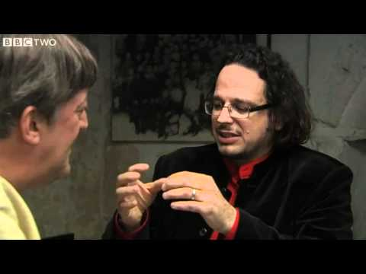
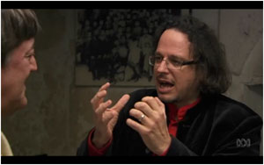
Professor Ghil‘ad Zuckermann

Slide 36
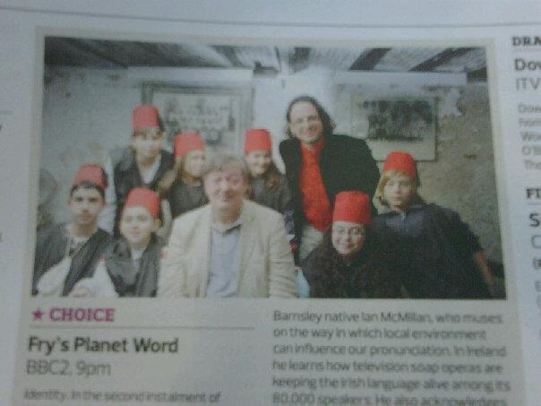
Professor Ghil‘ad Zuckermann

Slide 37
THE ISRAELI LANGUAGE
Professor Ghil‘ad Zuckermann

Slide 38
FORMS VERSUS PATTERNS
The distinction between forms and patterns is important. In the 1920s and 1930s, gdud meginéy hasafá, ‘the language defendants regiment’, whose motto was ivrí, dabér ivrít ‘Hebrew [i.e. Jew], speak Hebrew!’, used to tear down signs written in ‘foreign’ languages and disturb Yiddish theatre gatherings. However, the members of this group did not look for Yiddish and Standard Average European patterns in the speech of the Israelis who did choose to speak ‘Hebrew’.
Many people believe that language consists only of ‘nouns and sounds’. Forms – rather than patterns – are more visible and thus more accessible to the unsophisticated language analyst. Israelis know that the word perestróyka is a borrowing of the Russian-descent internationalism. However, few Israelis are aware that the common Israeli greeting má nishmà? is actually a calque of Yiddish vos hért zikh ‘what is heard?’, ‘what does one hear?’ Synchronically speaking, the forms in this phrase are 100% Hebrew, there is nothing to betray the non-Hebrew co-source. It is no wonder, then, that so many people miss much of the European impact on Israeli.
Professor Ghil‘ad Zuckermann

Slide 39
More generally, European mechanisms such as blending are apparent in Israeli word-formation. Thus, along with kómpaktdisk ‘compact disc’, Israeli has the blend taklitór, which consists of the Hebrew-descent taklít ‘record’ and ’or ‘light’. Unlike Hebrew, Israeli is full of ‘portmanteau blends’ such as arpíakh ‘smog’, from arafél ‘fog’ and píakh ‘soot’; and mídrakhov ‘(pedestrian) mall’, from midrakhá ‘pavement’ and rekhóv ‘street’. Furthermore, Israeli has cases of root blending, e.g. dakhpór ‘bulldozer’, which hybridizes d.ħ.p. ‘push’ and ħ.p.r. ‘dig’.
Whereas Israeli makeup (forms) has been much looked over, its ‘mindset’ (patterns) has been overlooked. For example, the (hidden) productivity and semantics of the allegedly completely Hebrew system of Israeli verb-templates are often Europeanized. Being linguistically naive, the revivalists cared much more about forms than about patterns. The result is that, generally speaking, whereas most forms of Israeli are Semitic, its patterns tend to be European.
Professor Ghil‘ad Zuckermann

Slide 40
Still, in addition to thousands of common lexical items of non-Semitic descent, Israeli abounds with various non-Semitic derivational affixes, which are applied to words of both Semitic and non-Semitic descent. Consider the following words consisting of a Hebrew-descent word and a non-Semitic-descent suffix: khamúda-le ‘cutie (fsg)’, from khamuda ‘cute (fsg) + -le, endearment diminutive of Yiddish descent; miluím-nik ‘reservist, reserve soldier’, from miluím ‘reserve’ (lit. ‘fill-ins’) + -nik, agent suffix of Yiddish and Russian descent; bitkhon-íst ‘one who evaluates everything from the perspective of national security’, from bitakhón ‘security’ + the internationalism -ist; kiso-lógya ‘the art of finding a political seat (especially in the Israeli Parliament)’, from kisé ‘seat’ + the internationalism - lógya ‘-logy’; maarav-izátsya ‘westernization’ (from maaráv ‘west’ + the internationalism –izátsya ‘-ization’). Examples of Israeli words which include an international prefix are post-milkhamtí ‘postwar’, pro-araví ‘pro-Arab’, anti-hitnatk‎út ‘anti-disengagement’.
There are two principles at the heart of my model:
Congruence Principle
Founder Principle
Professor Ghil‘ad Zuckermann

Slide 41
CONGRUENCE PRINCIPLE
Professor Ghil‘ad Zuckermann

Slide 42
THE congruence PRINCIPLE
By and large, whilst Israeli phonetics, phonology and syntax are mostly European, its morphological forms and basic vocabulary are mainly – albeit not exclusively – Semitic. The following figure illustrates this generalization:
European ← Mindset Phonetics Phonology Semantics Syntax Morphological.Forms Basic.Lexicon → Semitic
However, my research has demonstrated the Congruence Principle, supporting multiple causation and hybridization
(cf. Sally Thomason and Terrence Kaufman 1988):
Professor Ghil‘ad Zuckermann

Slide 43
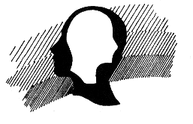
The Congruence Principle
(cf. natural selection, cross-fertilization, viral replication)
The more contributing languages a feature exists in,
the more likely it is to persist in the emerging language
(inadvertently, regardless of whether or not revivalists want that).
Professor Ghil‘ad Zuckermann

Slide 44
THE CONGRUENCE PRINCIPLE
What makes the genetics of Israeli so complex is the fact that the combination of Semitic and Indo-European influences is a phenomenon occurring already within the primary (and secondary) contributors to Israeli. Yiddish, a Germanic language with Romance, Hebrew and Aramaic influences (and with most dialects having undergone Slavonization), was shaped by Hebrew and Aramaic. On the other hand, Indo-European languages, such as Greek, played a role in (Semitic) Hebrew. Moreover, before the emergence of Israeli, Yiddish and other European languages influenced Medieval and Maskilic variants of Hebrew, which, in turn, influenced Israeli (in tandem with the European contribution).
Professor Ghil‘ad Zuckermann

Slide 45
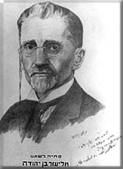
The Congruence Principle
Syllable structure
(C=consonant; V=vowel; X = C or V)
Hebrew: CV(X)(C)
Yiddish: (s/š)(C)(C)V(C)(C)(s/š) & CC (cf. Polish, Czech)
Israeli: (s/š)(C)(C)V(C)(C)(s/š)
      E.g. קציצה ktsitsa ‘meatball’
      שרימפס shrimps ‘shrimp’
      שטרונגול shtrungul ‘dick’
^{Eliezer Ben-Yehuda}
Professor Ghil‘ad Zuckermann

Slide 46
The Congruence Principle
In most contributing languages to Israeli (and unlike in Hebrew),
there is no polarity of gender.
The result in Israeli:
eser shekel ‘10 (masculine) shekels (masculine)’
rather than
asar-a shkalim ‘10 (feminine) shekels (masculine)
"הוֹשִׁיעָה אֶת עַמֶּךָ וּבָרֵךְ אֶת נַחֲלָתֶךָ וּרְעֵם וְנַשְּׂאֵם עַד הָעוֹלָם" (תהלים כ"ח ט')
Professor Ghil‘ad Zuckermann

Slide 47
The Congruence Principle
In most contributing languages to Israeli (and unlike in Hebrew),
f and p are phonemes
rather than allophones.
The result in Israeli:
  Minimal Pairs:
  leaFer – leaPer (לאפר – לאפּר)
  lehitkhaVer – lehitkhaBer (להתחבר – להתחבּר)
  In Hebrew [f] was an allophone of the phoneme /p/.
  In Israeli, /f/ is an independent phoneme.
Professor Ghil‘ad Zuckermann

Slide 48
The Congruence Principle
In most contributing languages to Israeli (and unlike in Hebrew),
There are no pharyngeal consonants.
The result:
Pharyngeal Consonants are pronounced in Hebrew but not in Israeli:
ע ח
ק ט צ
Professor Ghil‘ad Zuckermann

Slide 49
‘PHONO-SEMANTIC MATCHING’ (PSM, Zuckermann 2003)
PSM = Camouflaged borrowing in which a foreign lexical item is matched with a phonetically and semantically similar pre-existent native word/root.
Professor Ghil‘ad Zuckermann

Slide 50
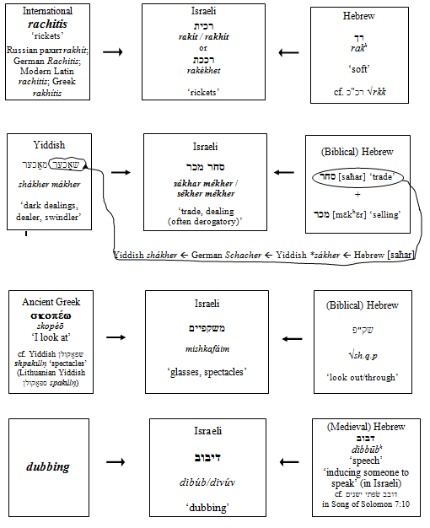
Professor Ghil‘ad Zuckermann

Slide 51
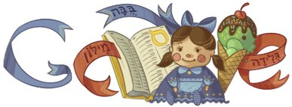
Two of three Israeli words here are phono-semantic matches:
buba ‘doll’ (top)
glida ‘ice-cream’ (right)
(Google.co.il, 7 January 2013)
Professor Ghil‘ad Zuckermann

Slide 52
Calquing
Israeli: מה נשמע má nishmà,
lit. ‘What does one hear? / What is heard?’,
i.e. ‘How are you?’
<<<
Yiddish: וואָס הערט זיך vos hert zikh (vsértsəkh),
lit. ‘What’s heard?, What does one hear?’, i.e. ‘How are you?’, ‘What’s up?’
+(2) Russian: Что слышно chto slyshno ‘id.’
+(3) Polish: Co sɫychać ‘id.’
+(4) Romanian: Ce se aude ‘id.’
Professor Ghil‘ad Zuckermann

Slide 53
Calquing
The useful outcome is that multi-layered Israeli has a historically-related minimal pair, the Yiddish-descent phrase being of a lower register compared with khashkhú enáv (thus pronounced in Israeli).
Professor Ghil‘ad Zuckermann

Slide 54
Horizontal Gene Transfer
Inadvertent Calquing in Israeli
"ועל כל מתנגדינו אנחנו מצפצפים!"
המשפט האחרון בהמנון גדוד מגיני השפה!
הפוסל ב"מומו" פוסל וטובל ו"שרץ" בידו:
מיר פייפן זיך אויף אונדזערע שונאים אויס.
הישראלית איננה רצח יידיש אלא יידיש רעדט זיך:
היידיש מִתְדבּרת בתוך הישראלית.
Professor Ghil‘ad Zuckermann

Slide 55
Horizontal Gene Transfer
Calquing in Reclaimed Barngarla
gabiwa ‘computer’ < triple clipping <
gagabibiwaribirga <
Gaga Bibi ‘brain’ [from gaga ‘head’ + bibi ‘jelly substance’ (such as egg)]
+Waribirga ‘lightning’
Note that gabiwa alludes to gabmididi ‘learning’ as in GABMIDIDI BARNGARLIDI MANOO, i.e. ‘learning and speaking Barngarla together’ (the name of the language reclamation workshops and project)
The word wabma means ‘wise’ – see Lutheran missionary Clamor Schürmann (1844: 64).
Professor Ghil‘ad Zuckermann

Slide 56
Horizontal Gene Transfer
Barngarla GABIWA is modelled upon
Te Reo Māori rorohiko ‘computer,
lit. ‘lightning brain’, compounding of roro ‘brain’ + hiko ‘lightning’ (and the latter consequently ‘electricity’).
Yet another horizontal gene transfer occurred between Māori and Kaurna:
mukarntu, lit. ‘lightning brain’, i.e. ‘computer’,
a portmanteau blending of
mukamuka ‘brain’ (note the reduplication)
+ karntu ‘thunder, lightning’
Professor Ghil‘ad Zuckermann

Slide 57
Stammbaum (Family Tree)
Stammbaum (Family Tree) → Jones → Herschel → Darwin → Tree of Life (→ Network of Life)
The speciation is more gradual than one might think.
There is vertical gene transfer even after the alleged speciation – see, e.g. Homo sapiens sapiens that is several percent Homo neanderthalensis.
A reclaimed language as a Frankensteinian Phinocchio?
Tree of Life →→→→ Network of Life
Professor Ghil‘ad Zuckermann

Slide 58
Horizontal Gene Transfer:
Ruthlessly Rootless Verb-Templates in Israeli
Hishprits (verb) < Shprits (stem)
Hiklik (verb) < Klik (stem)
Trinsfer (verb) < Transfer (stem)
Fikes (verb) < Fokus (stem)
Fikses (verb) < Faks (stem)
Fibrek (verb) < Fabrika (stem)
Piprek (verb) < Paprika (stem)
Cf. Lenaratev (verb) ‘to produce a narrative’
(Used by Prof. Yigal Schwartz at a conference at Bar-Ilan University in December 2012)
←Minimal Pair
Professor Ghil‘ad Zuckermann

Slide 59
Horizontal Gene Transfer:
A New Adjective Template in Israeli (from Arabic)
Israeli neologisms:
maFLuTS
maGNuV
(A New Adjective Pattern: ma□□u□)
cf. Arabic loanwords within Israeli:
maJNuN
maDRuB
maHaBuL
Professor Ghil‘ad Zuckermann

Slide 60
FOUNDER PRINCIPLE
Professor Ghil‘ad Zuckermann

Slide 61
The Founder Principle
The revivalists’
(and documenters’)
mother tongue(s)
are the primary contributors
to the emerging language (even if the revivalists do not want them to be).
Professor Ghil‘ad Zuckermann

Slide 62
THE FOUNDER PRINCIPLE
Most Israelis believe that their language is different from Biblical Hebrew in exactly the same way as the English of the American novelist John Grisham (b. 1955) is different from that of William Shakespeare (1564-1616), let alone Geoffrey Chaucer (c. 1343-1400). Others might refer you to the Greek spoken in today’s Athens, in contrast to that of the playwright Aristophanes (c. 448-380 BC), the historian Thucydides (c. 460-400 BC) or the language of Homer’s Iliad and Odyssey. Many linguists still argue that the role of Yiddish in Israeli is no different from that of other languages such as Judaeo-Spanish (a.k.a. Ladino), Arabic and English. Such a view is confuted by the Founder Principle, which emphasizes the impact of the founder population:
Yiddish is a primary contributor to Israeli because it was the mother tongue of the vast majority of revivalists and first pioneers in Eretz Yisrael at the critical period of the beginning of Israeli.
Professor Ghil‘ad Zuckermann

Slide 63
At the same time I suggest that lethargic liturgical Hebrew too fulfills the criteria of a primary contributor for the following reasons:
(i) Despite millennia without native speakers, it persisted as a most important cultural, literary and liturgical language throughout the generations;
(ii) Revivalists made a huge effort to revive it and were, in fact, partly successful.
Professor Ghil‘ad Zuckermann

Slide 64
The Founder Principle works because by the time later immigrations came to Israel, Israeli had already entrenched the fundamental parts of its grammar. Thus, Moroccan Jews arriving in Israel in the 1950s had to learn a fully-fledged language (even though it often did not appear so to the Hebrew-obsessed language planners). Obviously, they initially developed their own variety of Israeli but ultimately the influence of their mother tongue was relatively negligible. ‘The oldest features have a greater chance of prevailing over some newer alternatives simply because they have acquired more and more carriers, hence more transmitters, with each additional generation of speakers’ (Salikoko Mufwene 2001: 29).
Professor Ghil‘ad Zuckermann

Slide 65
Had the Moroccan Jews arrived in Israel first, had Ben-Yehuda (born Perelman) been an Abarjel…, Israeli would have been a totally different language, much more Semitic!
Thus, comparing Israeli to Semitic languages characterized by both Indo-European traits (like Israeli) and a continuous genetic chain of native speakers (unlike Israeli) is problematic. Pace traditionalists, the formation of Israeli is not the result of language contact between Hebrew and a prestigious, powerful superstratum ­– such as English in the case of Arabic, or Kurdish in the case of Neo-Aramaic. Rather, ab initio, Israeli had two primary contributors: Yiddish and Hebrew. While Kurdish is a superstratum for Neo-Aramaic, Yiddish is a primary contributor for Israeli. The two cases are, therefore, not parallel.
Professor Ghil‘ad Zuckermann

Slide 66
The case of Israeli demonstrates that the reality of linguistic genesis is far more complex than a simple family tree system allows. It might well be the case that ‘each language has a single parent’ ‘in the normal course of linguistic evolution’ (Dixon 1997: 11-13) but not in the case of a ‘non-genetic’ language resulting from semi-engineering. Thus, the comparative historical methodology, which I often rely on – as well as the problematic comparative lexico-statistics (cf. Swadesh 1952) – cannot explain the intricate genesis of Israeli.
Professor Ghil‘ad Zuckermann

Slide 67
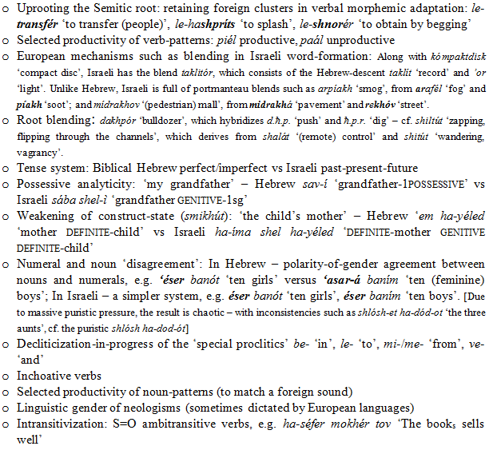
MORPHOLOGY
Professor Ghil‘ad Zuckermann

Slide 68
MORPHOLOGY
Professor Ghil‘ad Zuckermann

Slide 69
SYNTAX
Constituent order: Biblical Hebrew VSO (VAO / VS) vs Israeli SVO (AVO / SV(E))
Habere language: yésh li X ‘there.is for.me X’ (‘I have X’) –
in Hebrew X is NOMINATIVE; in Israeli X is ACCUSATIVE
Verb-Subject ‘disagreement’: koév li ha-béten ‘hurts (masculine) me the stomach (feminine)’ (‘My stomach hurts’)
Increased use of the copula: késef ze lo ha-kól ‘Money is not everything’
Tautological infinitives: le-dabér, hu medabér ‘To speak, he speaks…’
Professor Ghil‘ad Zuckermann

Slide 70
The Founder Principle
Word order:
Biblical Hebrew: Verb-Subject-Object
Yiddish (most revivalists’ mother tongue): Subject-Verb-Object
(as in most other European tongues spoken by revivalists)
Israeli: Subject-Verb-Object
Professor Ghil‘ad Zuckermann

Slide 71
Cf.
Word order:
Vedic Sanskrit: Free (due to the presence of eight cases)
Hindi (most revivalists’ mother tongue): Subject-Object-Verb
Neo-Sanskrit: Subject-Object-Verb
Kaurna (the Aboriginal language of Adelaide): Subject-Object-Verb (like most Aboriginal tongues)
English (most revivalists’ mother tongue): Subject-Verb-Object
Reclaimed Kaurna: Subject-Object-Verb or Subject-Verb-Object (to be determined in due course, when there are native speakers. My prediction: SVO)
Professor Ghil‘ad Zuckermann

Slide 72
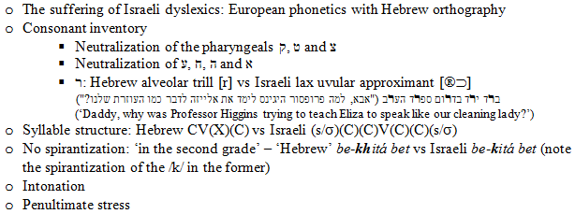
THE PERVASIVE IMPACT OF YIDDISH AND ‘STANDARD AVERAGE EUROPEAN’ ON ISRAELI (SELECTION)
PHONETICS (VIS-À-VIS ORTHOGRAPHY) AND PHONOLOGY
Professor Ghil‘ad Zuckermann

Slide 73
Cf. Hawai’i
Classical Hawaiian (1000 native speakers):
hoehoe ‘to paddle a canoe’
versus
hoihoi ‘interesting, fun’
Neo-Hawaiian (3000 still non-native speakers)
Both words are pronounced the same, reflecting American English: hoyhoy
Professor Ghil‘ad Zuckermann

Slide 74
Cf. Emblematicity rather than Authenticity
Classical Ngarrindjeri (South Australia)
Ngarrindjeri
Neo-Ngarrindjeri
Ngarrindjerri
Professor Ghil‘ad Zuckermann

Slide 75
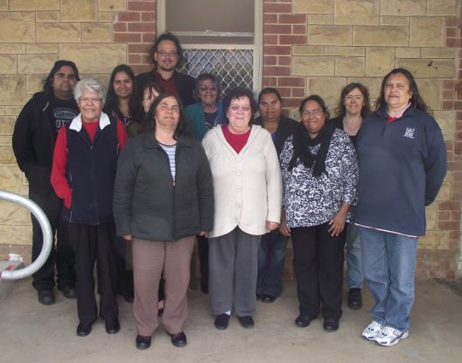
With Ngarrindjeri people taking part in the revival of the
Ngarrindjeri language (with Dr Mary-Anne Gale, Adelaide University), Murray Bridge, 9 Sept. 2011
Professor Ghil‘ad Zuckermann

Slide 76
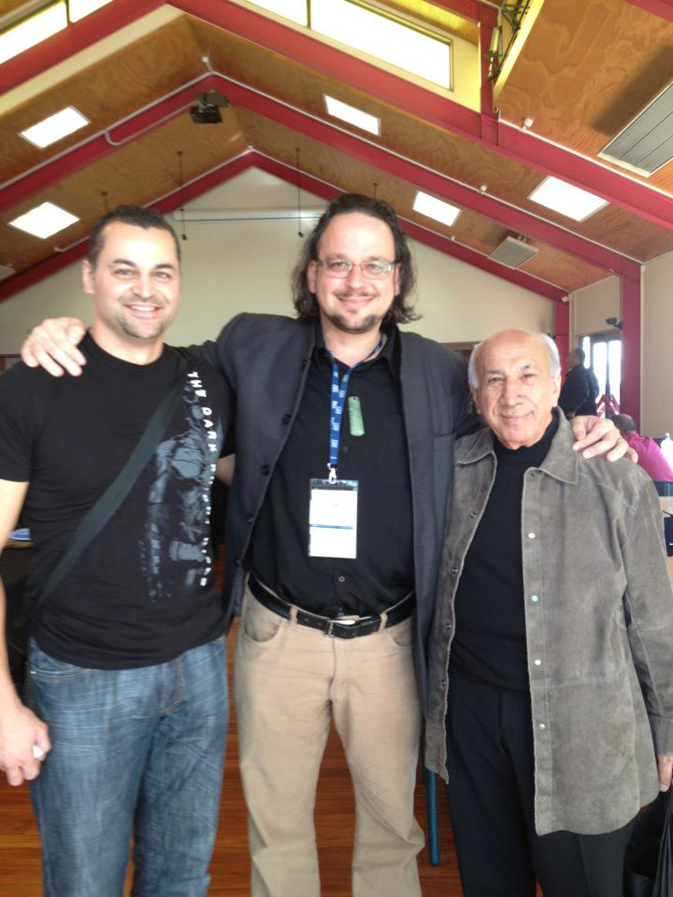
Network of Life in
Te Reo Māori
Revitalization
Scotty Morrison (TVNZ) (left)
and
Tīmoti Kāretu (right)
(Auckland, New Zealand, 13 September 2012)
Professor Ghil‘ad Zuckermann

Slide 77
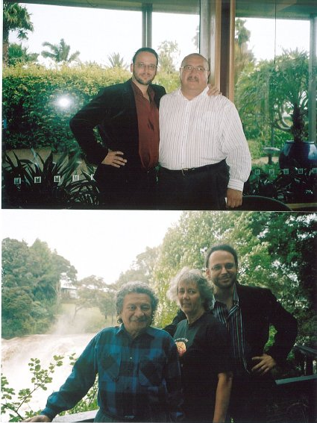
Waitangi Day
Waitangi
New Zealand
6 February 2007
← Erima Henare, Chairman of the Māori Language Commission (Te Taura Whiri i te Reo Māori)
← Patu Hohepa (<Patrick Joseph) (Māori linguist and leader) and wife.
Professor Ghil‘ad Zuckermann

Slide 78
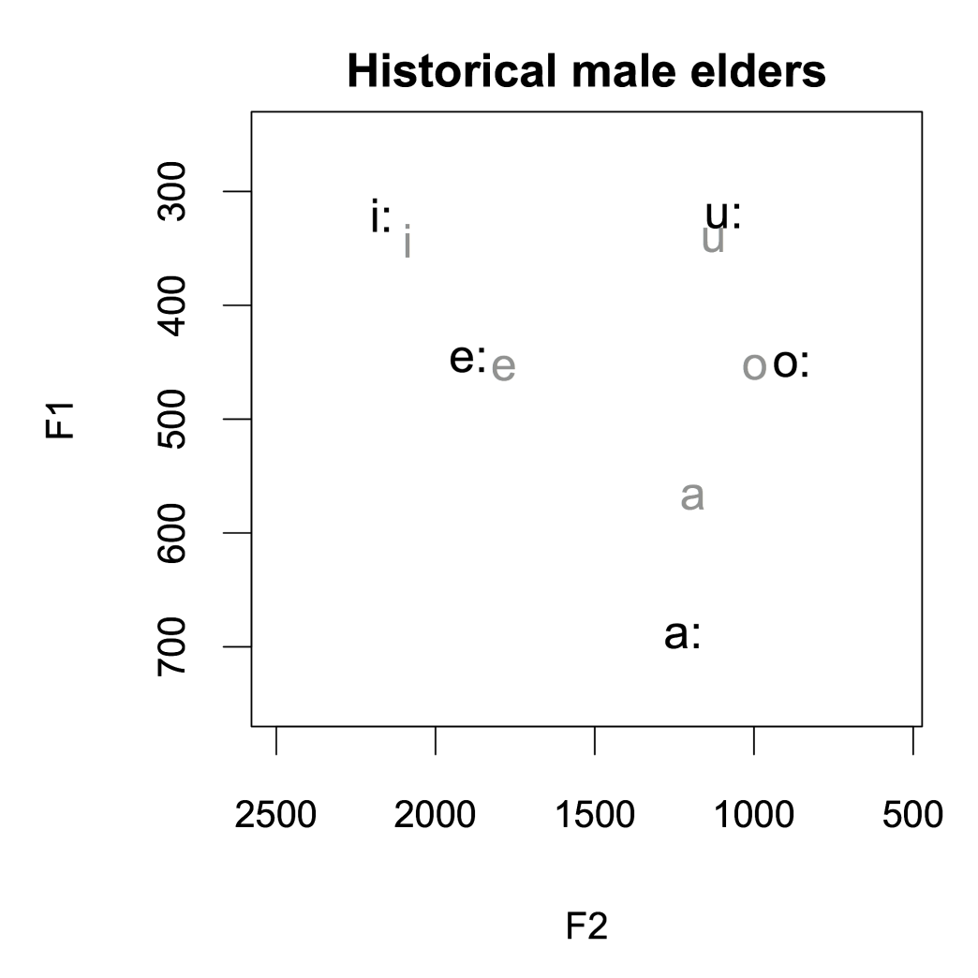
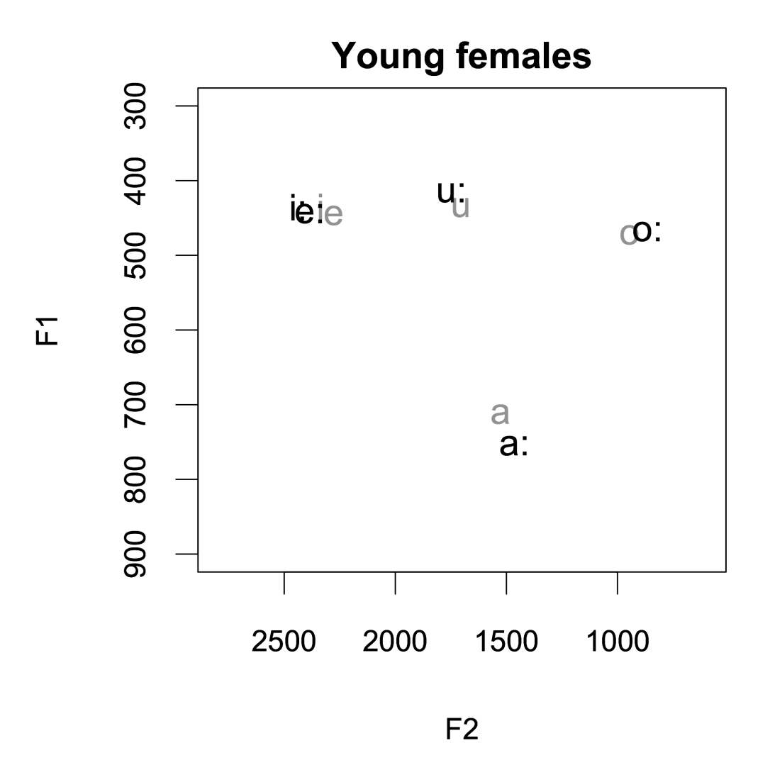
Horizontal Gene Transfer in Te Reo Māori:
Pronunciation of Māori /i/ and /e/ by young females – as a reflection of New Zealand English
Professor Ghil‘ad Zuckermann

Slide 79
Shift happens (among women)
The vowel space of the historical male elders (born in the 1870s-1880s and recorded in the late 1940s) shown here largely represents the Māori version of the stable vowel space which had moved across the Pacific over two millennia (Krupa 1982).
Professor Ghil‘ad Zuckermann

Slide 80
Shift happens (among children)
When we move to the vowel space of the youngest group of eight young female speakers (born in the 1980s and recorded in the mid naughties) we see that
the raising of both front and back mid-vowels has substantially advanced
so that pī and kē are (or piki and kete)
now largely sharing the very same vowel space.
Professor Ghil‘ad Zuckermann

Slide 81
Shift happens (among women)
In comparison with the vowel space of the young male speakers, their female contemporaries are leading in respect of the raising of kē and kete, the fronting of tū and tuku and the fronting of wā and waka.
Some young female speakers have fronted tū/tuku even more than indicated in this slide, so that they are starting to encroach on the already crowded high front vowel space shared by pī/piki and kē/kete!
Professor Ghil‘ad Zuckermann

Slide 82
Shift happens (among women)
Reference:
Jeanette King, Ray Harlow, Catherine Watson, Peter Keegan, Margaret Maclagan 2009. “Changing Pronunciation of the Māori Language Implications for Revitalization”, pp. 85-96 of Jon Reyhner and Louise Lockard (editors), Indigenous Language Revitalization: Encouragement, Guidance & Lessons Learned. Flagstaff: Northern Arizona University.
Professor Ghil‘ad Zuckermann

Slide 83
CONCLUDING REMARKS
Professor Ghil‘ad Zuckermann

Slide 84
PROPOSED PERIODIZATION OF HEBREW AND ISRAELI (Zuckermann 2000)
Professor Ghil‘ad Zuckermann

Slide 85
Despite their European mindset, the revivalists, most of them native Yiddish-speaking, wished to speak Hebrew, with Semitic grammar and pronunciation, like Arabs. But their attempts (1) to deny their (more recent) roots in search of Biblical ancientness, (2) negate diasporism and disown the ‘weak, persecuted’ exilic Jew from public memory, and (3) avoid hybridity (as reflected in Slavonized, Romance/Semitic-influenced, Germanic Yiddish itself, which they regarded as zhargón) failed.
Professor Ghil‘ad Zuckermann

Slide 86
Thus, the study of Israeli offers a unique insight into the dynamics between language and culture in general and in particular into the role of language as a source of collective self-perception. Linguists and community leaders seeking to apply the lessons of Israeli in the hope of reviving no-longer spoken languages – which is a wonderful cause – should be realistic rather than puristic.
Professor Ghil‘ad Zuckermann

Slide 87
Under the current talknological phase, when one revives a language successfully, one should expect to end up with a hybrid.
Israeli is a hybridic Eurasian language, both Semitic (Afro-Asiatic) and (Indo-) European. Whatever we choose to call it, we should acknowledge, and celebrate, its complexity.
Professor Ghil‘ad Zuckermann

Slide 88
Professor Ghil‘ad Zuckermann 诸葛漫
D.Phil. (Oxon.)
Chair of Linguistics of Endangered Languages, The University of Adelaide
Distinguished Visiting Professor:
Weizmann Institute of Science
Shanghai Jiao Tong University
Mahidol University
ghilad.zuckermann@adelaide.edu.au
http://www.adelaide.edu.au/directory/ghilad.zuckermann
http://www.facebook.com/ProfessorZuckermann
Professor Ghil‘ad Zuckermann

Slide 89
I suppose the process of acceptance will pass through the usual four stages:
  This is worthless nonsense.
  This is an interesting, but perverse, point of view.
  This is true, but quite unimportant.
  I always said so.
John Burdon Sanderson Haldane (1963: 464)
Professor Ghil‘ad Zuckermann

Slide 90
I may be wrong
But I am certain!
Professor Ghil‘ad Zuckermann

Slide 91
I disapprove of what you say, but I will defend to the death your right to say it.
Evelyn Beatrice Hall
p. 199, of her 1906 book
The Friends of Voltaire
Professor Ghil‘ad Zuckermann

