Slide 1
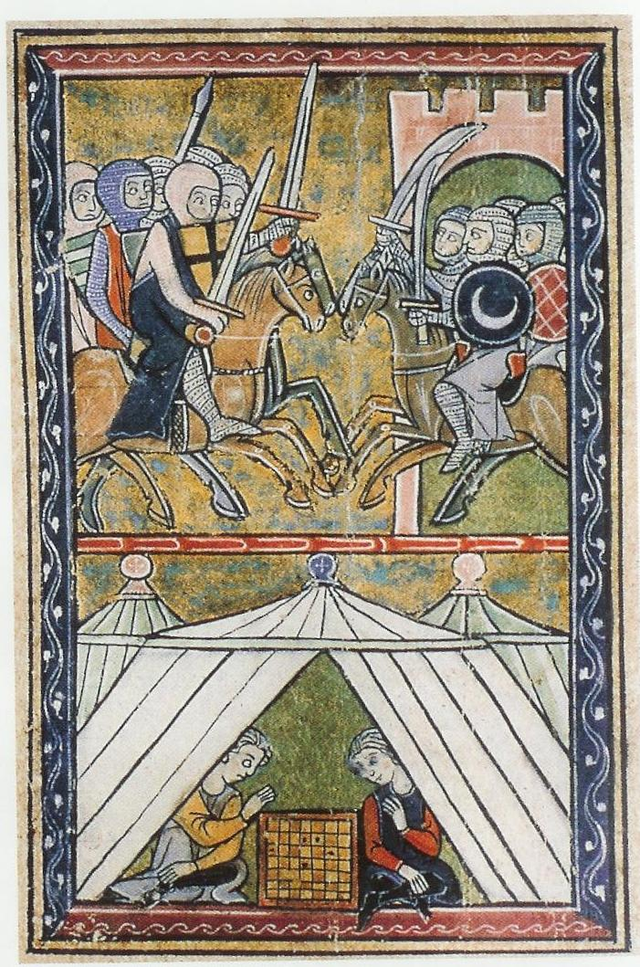
Contested Space: Jerusalem during the Crusades and Counter-Crusades
Daniella Talmon-Heller
Ben-Gurion University of the Negev
Notes:
A 13th century illustration of William of Tyre’s Latin chronicle. Crusaders attacking; portrayal of leisure. An age of violence with relatively peaceful intervals, and some cultural exchange.

Slide 2
Contested Space/ Shared Space?
“The most holy, most royal, most noble, and magnificent above all cities of the world…
For all generations of the world call you holy, as from the first Christians, Jews, Saracens, Jacobites, Nestorians, Georgians, Ethiopians, Copts, Arabs, Turks, Berbers, and Pagans.”
Niccolò, a Franciscan friar from Poggibonsi, Tuscany (1348)
Notes:
Christian monk acknowledging Jerusalem multi-layered and multi-faceted sanctity, several decades after the final expulsion of the crusades from the holy land.

Slide 3
Shared/Contested Heritage
“The uniqueness of Jerusalem is that most of its memories were Jewish, but that these Jewish memories became Christian, and Christian and Jewish memories became Muslim. Alone, of all the holy cities in the world, the space of Jerusalem could accommodate all these pious expressions in every one of their confessional garbs."
(Oleg Grabar, Jerusalem: Its Sanctity and Centrality to Judaism, Christianity, and Islam, New York: 1999, p. 285)
Notes:
Articulated by a great art historian who devoted years of study to the meaning of Islamic architecture in Jerusalem. Purpose of lecture: present fascinating chapter in history of Jerusalem ; examine the space accommodated not only a variety of confessional garbs but also competing political narrative, appropriation and expropriation of space, construction and reconstruction.

Slide 4
Jerusalem and the Middle East on the Eve of the Crusades
Fatimid rule (969- 1099)
Al-Hakim’s destruction of Holy Sepulcher (1009)
Jewish Rabbanite and Karaite presence and ceremonies
1033 earthquake, and massive reconstruction
Seljuq (Turk) conquests (1073-1098)
Compilation of Islamic “Merits of Jerusalem” (Fada’il Bayt al-Maqdis) treatises
Notes:
Short historical introduction. Al-Hakim’s policy as triggering the crusade; otherwise – tolerant regime, Jewish re-settlement (esp. Karaite ‘mourners of Zion’), establishment of Jewish processions and ceremonies on Mt Olives; Fatimid massive building projects enhance pilgrimage of all denominations; Fada’il: based on biblical narratives about creation, Abraham’s sacrifice, Jacob’s ladder, David and Solomon and the construction of the temple, the wonders of the rock, the great worth of good deeds performed in J, eschatological traditions, etc.

Slide 5
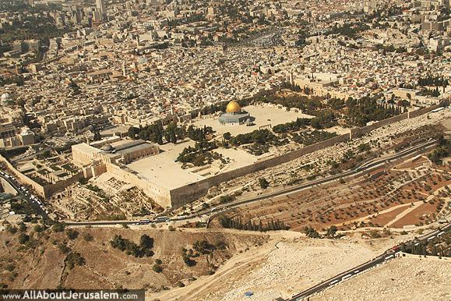
Temple Mt / al-Haram al-Sharif / al-Aqsa Mosque
Notes:
Whole esplanade regarded as mosque; Fatimids add commemorative shrines, desired burial site in anticipation of drama of final Judgement. Focus of sanctity for Muslims and Jews (who could look at it from Mt. Olives, from the east). Ignored by Christians – focus on holy sepulcher and Mt Olives.

Slide 6
Pilgrims of all denominations
Nasir Khosraw (1046): “20,000 each year.”
Rodulfus Glaber of Burgundy (980-1046): "an innumerable multitude of people from the whole world…finally, and this was something which had never happened before, numerous women, noble and poor.“
Gaon Elijah b. Shlomoh (1057): “on Mount Olives… all our brethren, the house of Israel, assemble on the month of Tishrei to pray in front of the stones of Jerusalem and to kiss its earth, and circumambulate its gates.”

Slide 7
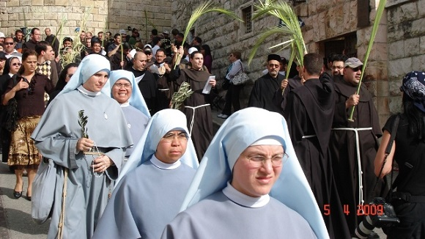
In the footsteps of Jesus

Slide 8
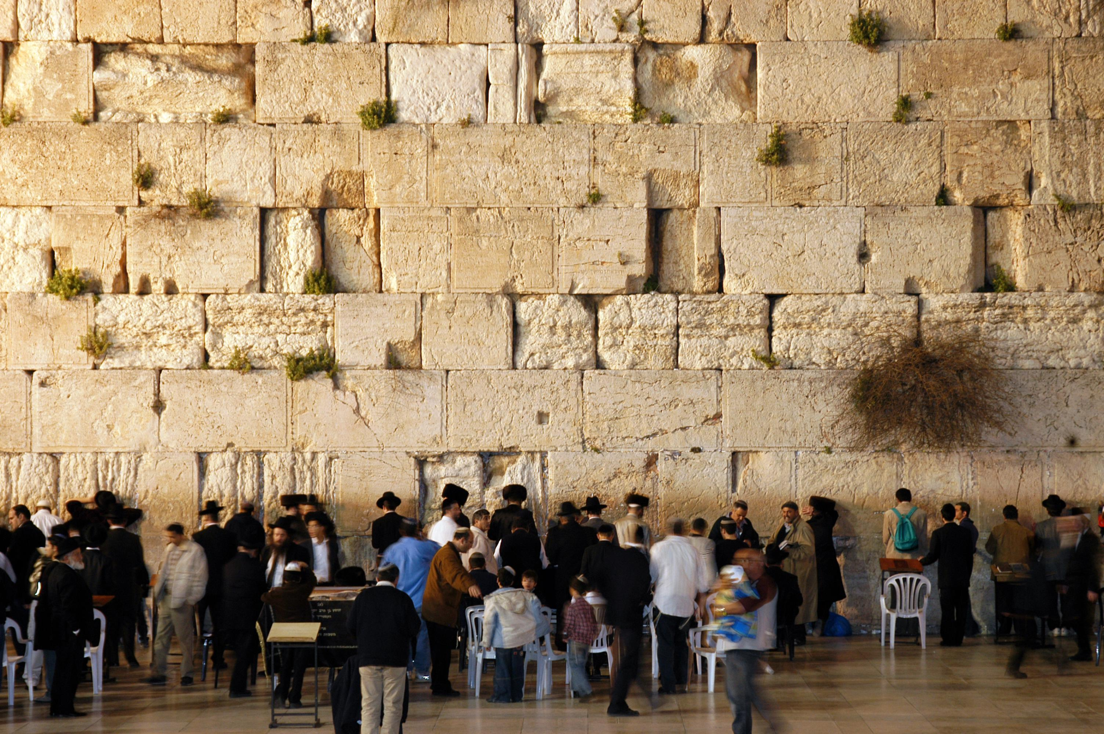
To cry…
Notes:
Especially Karaite mourners of Zion

Slide 9
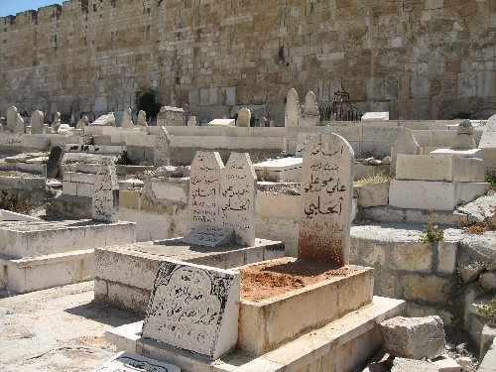
Or to die…
Muslim cemetery, vicinity of Golden Gate
Notes:
one thing Jews, Muslims and Christians agree about…

Slide 10
Christian Pilgrims (humiliated) in front of the Holy Sepulcher Ms Fr 2810 fol.274

Slide 11
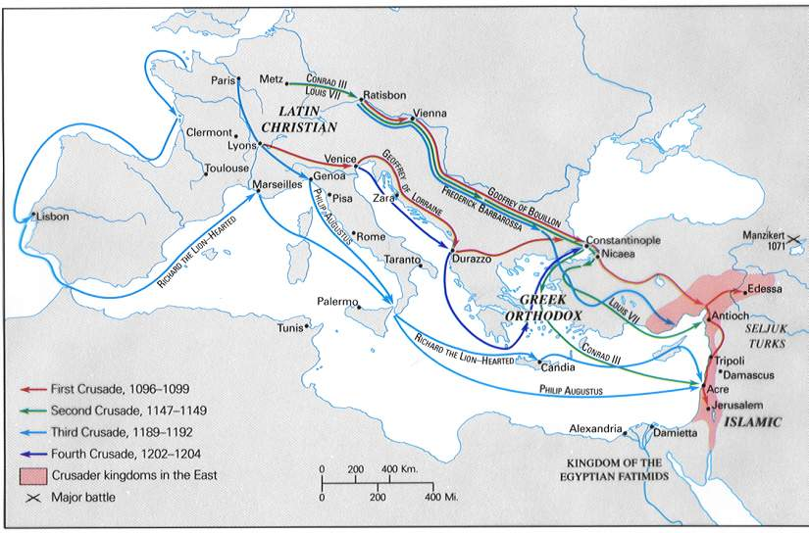
Pilgrimage in arms? First Four Crusades (1096-1204); Kingdom in 1135
Notes:
Pilgrimage in arms? Consequence of transformed Christian theology (from pacifism to war in the name of Christ), special political circumstances in Europe and in the ME, ambitious Pope, fervent religiosity in the wake of the millennium

Slide 12
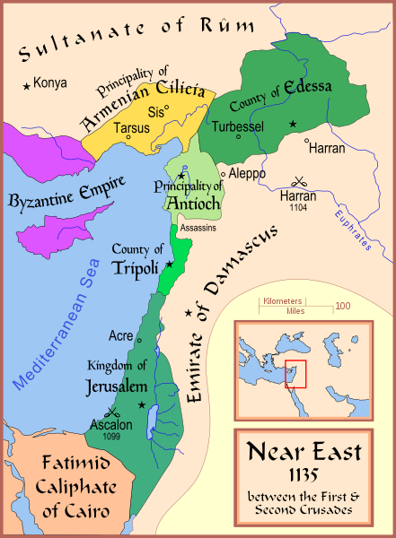
Notes:
Kingdom at its largest , all crusading principalities. Incubation of counter-crusade / unification of Muslim principalities and preparation for jihad. First significant success – 1144.

Slide 13
Basic Chronology: 88+10 years of Latin Rule
1095: Proclamation of First Crusade at Clermont. Thousands enlist. For the redemption of Jerusalem? For Christian brethren in the East?
1099: siege and bloody conquest of Jerusalem; “religious cleansing.” al-Aqsa turned into royal palace.
1100 coronation of first King of Jerusalem
1187 capture of Jerusalem by Muslims
1192 negotiations between Richard Lionheart and Saladin
1129-1139 Frederich
Notes:
1099 seven days of carnage. 3000/30000/100000 dead? Unplanned establishment of monarchy and administrative capital. Jews and Muslims banned from living; individuals visit and pray. Others express their longing “How shall I render my vows and my bonds, while yet Zion lieth beneath the fetter of Edom, and I in Arab chains?” Yehudah Halevi (d. 1141, apparently on the way).

Slide 14
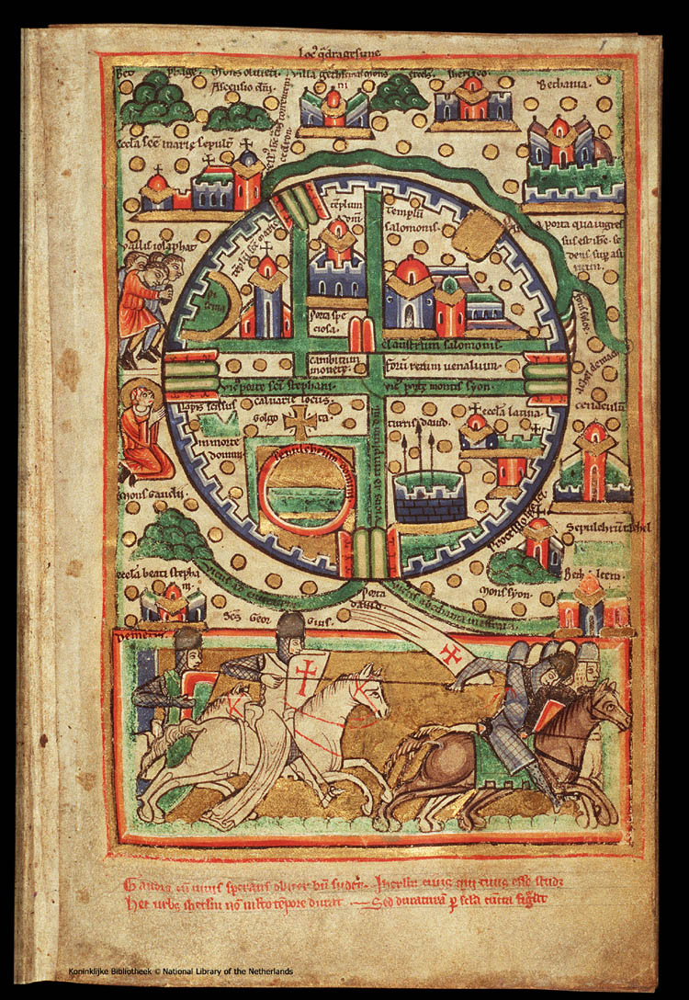
Capital of The Latin Kingdom of Jerusalem
Notes:
“The Haag map.” Fortified city with 5 gates. Closed from sunset to sunrise. David’s gate most important, protected by tower – stronghold and administrative center, symbol of Crusader Jerusalem, appears of coins and seals.. Quarters: Patriarch’s (adjacent to Holy Sepulcher), Hospitalers (order as of 1130) south of Sepulcher, Syrian (previously the Jewish Q), Armenian. Temple Mt – Templar’s Quarter (after 1119).

Slide 15
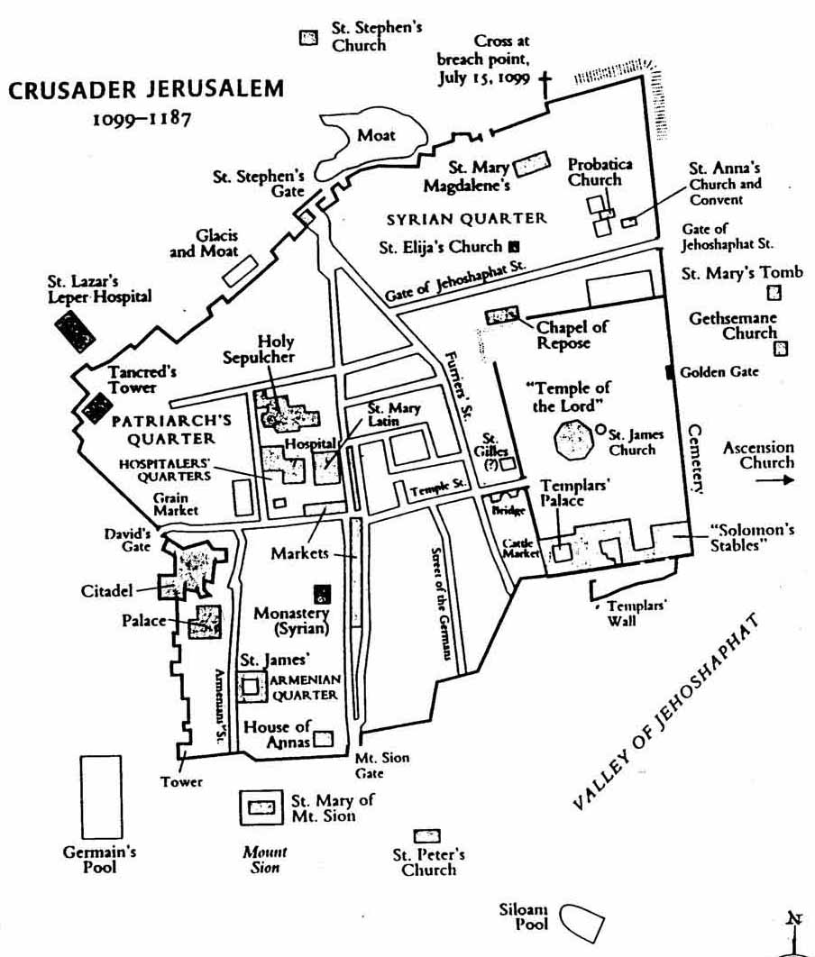
Notes:
Extensive building of churches (more than 40) to replace those destroyed by al-Hakim, of facilities for pilgrims (hospices, hospitals, markets), of governmental and ecclesiastical institutions (palace, mint, treasury). An effort to re-populate a ghost town, and to create a new “axis” of sanctity. When the holy fire fails to descend – the went barefoot to pray on Temple Mt. The size of today’s old city (square km, one fifth the Haram), estimated 25-30000 inhabitants.

Slide 16
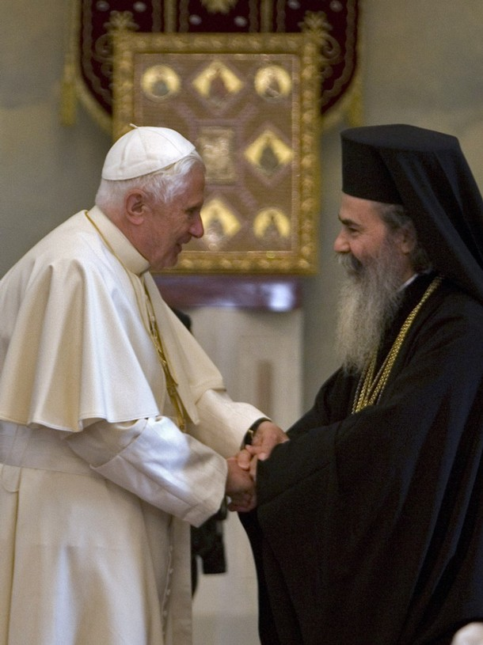
Pope Benedict XVI greeted by Greek Orthodox Patriarch Theofilos III, Jerusalem, May 2009. Authentic portrayal of friendly relations?
Notes:
The Pope and the Greek Orthodox patriarch are smiling, but Greek Orthodox, Roman Catholic, Armenian, Coptic, Assyrian, Ethiopian churches have quarreled for centuries and still quarrel over control of holy places. Strained relations / open hostility in crusading period. Hierarchical society: Latin Christians – Oriental Christians – Muslims & Jews (or: Christians – non-Christians ?)

Slide 17
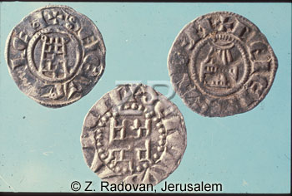
CRUSADER PERIOD COINS ISSUED IN JERUSALEM WITH THE SYMBOLS OF THE CITY RIGHT: THE HOLY SEPULCHER; LEFT: TEMPLE MOUNT; CENTER: THE JERUSALEM CITADEL

Slide 18
Sanctity and Liturgy
Two religious centers:
the Church of the Holy Sepulcher
Mt. Moriah
new axis of sanctity, new narratives and rituals,
processions between the two
Notes:
Upon coronation of new king, with holy fire, etc.

Slide 19
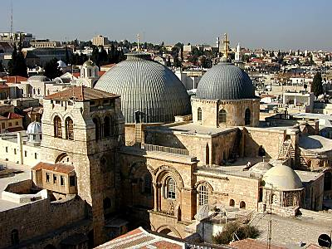
Holy Sepulcher: site of the crucifixion, anointing, and burial
Notes:
.inaugurated in 335 by emperor Constantine. Made into large pilgrimage basilical church by crusaders.

Slide 20
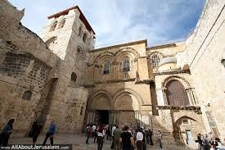
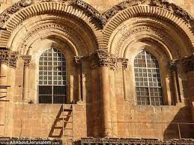
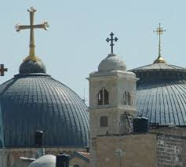
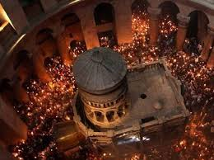
1149
Festive Inauguration
Notes:
50th anniversary of conquest. Rebuilt as great romanesque pilgrimage church (reminiscent of churches on the way to Compostella, north western Spain. Typical stonework, arches, vaults and capitals. Bustling pilgrimage center!

Slide 21
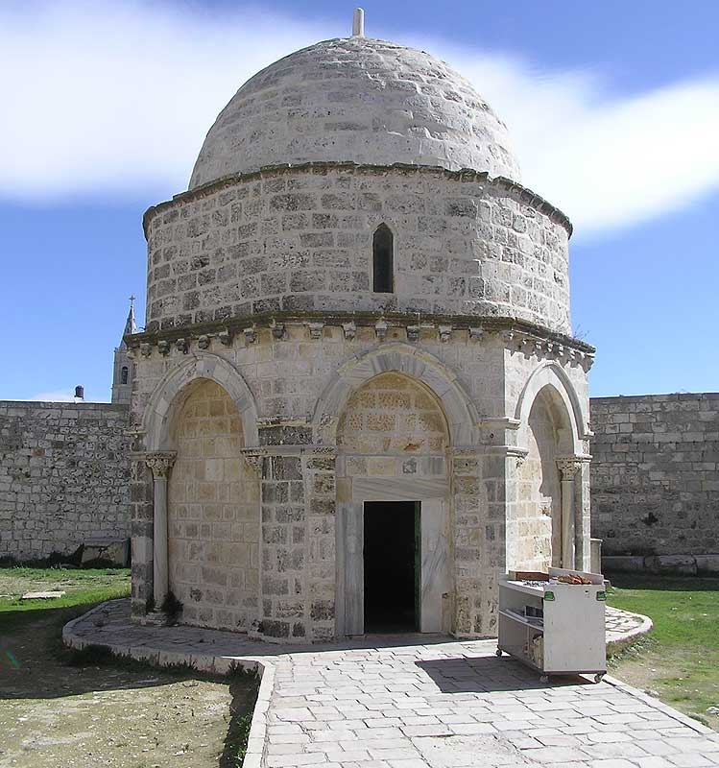
Chapel of the Ascension (Mt. of Olives)
Notes:
Overlooking the deserted ruins of the temple, Symbol of victory over Judaism, purposefully not rebuilt by Byzantines.

Slide 22
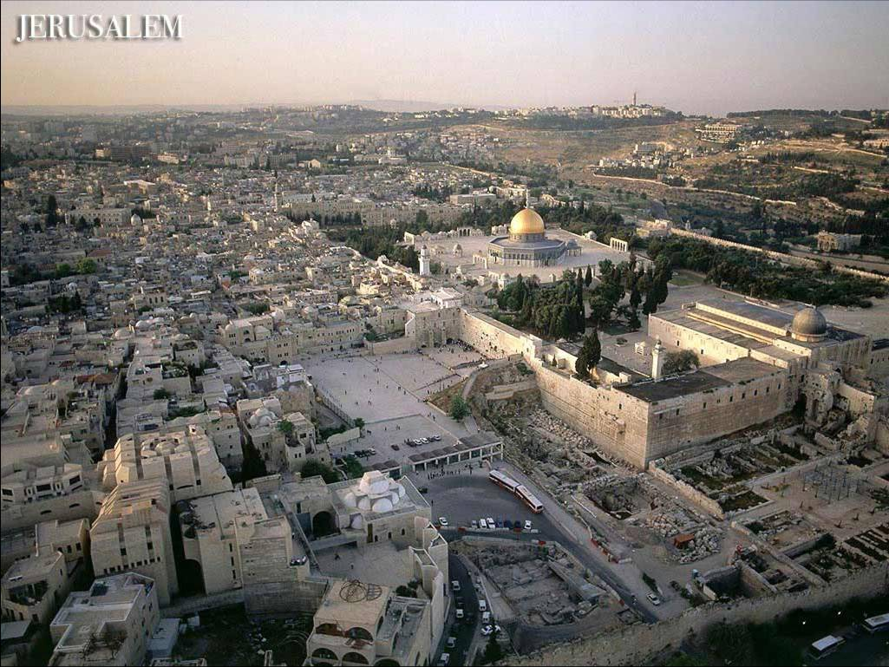
Templum Domini (Augustinian church); Templum Salomonis (headquarters of Templars); stables
Notes:
Reconstruction of narratives: Jacob’s ladder, footprint of Jesus, erection by Heraclius or Helena, Marian legends

Slide 23
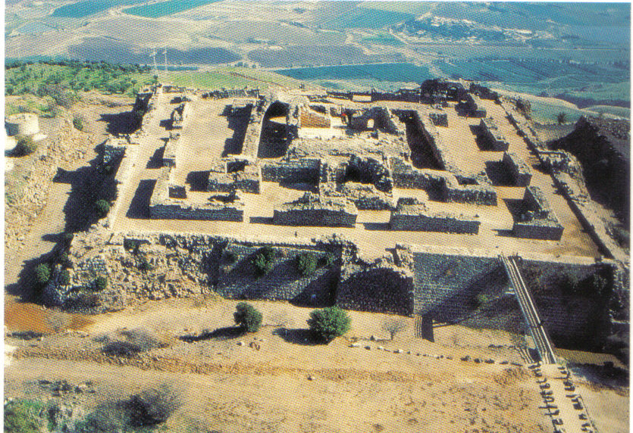
Military Architecture: Belvoir Castle (1149)
Notes:
Monks in arms - significant part of Kingdom’s forces

Slide 24
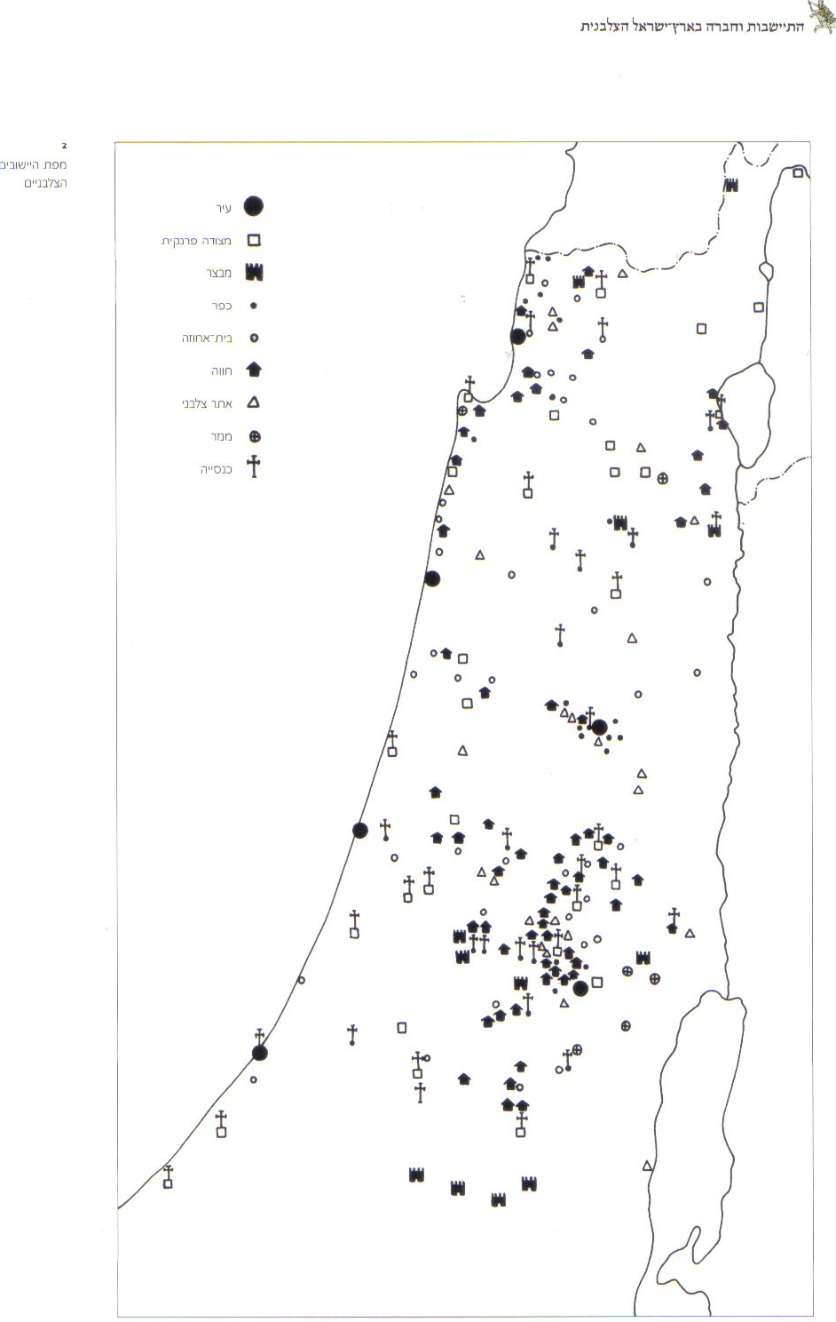
Crusader castles, towns, villages, farm-houses and churches (Ronnie Ellenblum)
Notes:
Widespread settlement after all…

Slide 25
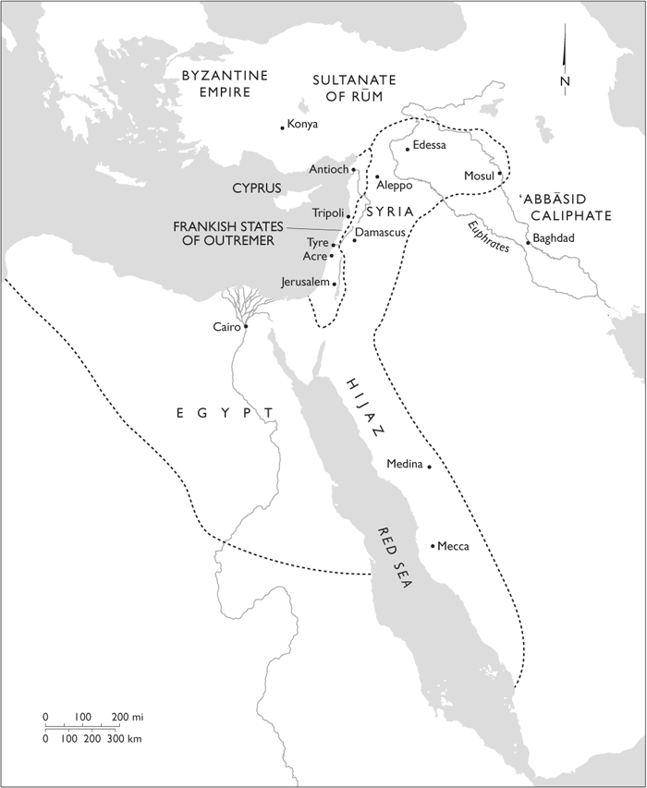
Saladin’s Kingdom on the eve of the Battle of Hattin (July 1187)
Notes:
Crusader states surrounded by unified Muslim state committed to jihad and the liberation of Jerusalem at least since 1144 (if not from the 1105 sermons of al-Sulami in Damascus

Slide 26
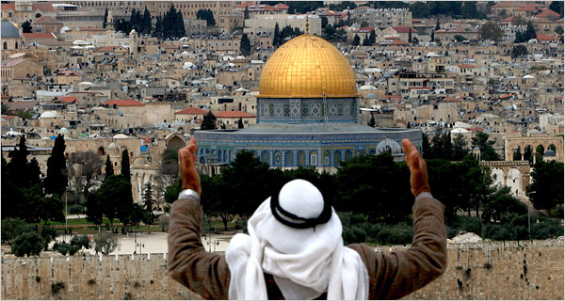
“Ula al-Qiblatayn, thani al-Masjidayn, thalith al-Haramayn”
Notes:
Supposedly, a Muslim Guide showing tourists how to best capture the dome in a photograph… symbolically emphasizing Muslim claim to Jerusalem as first direction of prayer, second mosque, third noble sanctuary

Slide 27
“How could God not assist in the conquest of the mighty Jerusalem and of the al-Aqsa Mosque… since she is the seat of the prophets, the home of the saints… [where] angels visit… There is the rock, from which the Way of the Ascension (mi`raj) leaves… and for there Buraq departed on the night of the heavenly journey… within it are the throne of Solomon and the Oratory of David… Jerusalem is the first qibla, the second of the two houses of God, and the third sacred sanctuary”
(`Imad al-Din al-Isfahani, summer of 1187)
Notes:
Saladin’s secretary motivating the warriors. After victory – on Rajab 27 (Day of the night journey!) - claims that a new calendar, beginning from this victory, should replace the beginning with the hijra!

Slide 28
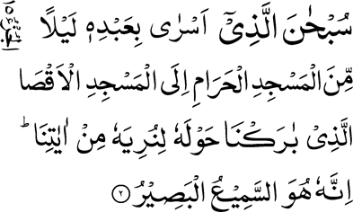
The Night Journey (17: 1)
“Glory be to Him Who made His servant go on a night from the Sacred Mosque to the remote mosque (al-masjid al-aqsa) of which We have blessed the precincts, so that We may show to him some of Our signs; surely He is the Hearing, the Seeing.”

Slide 29
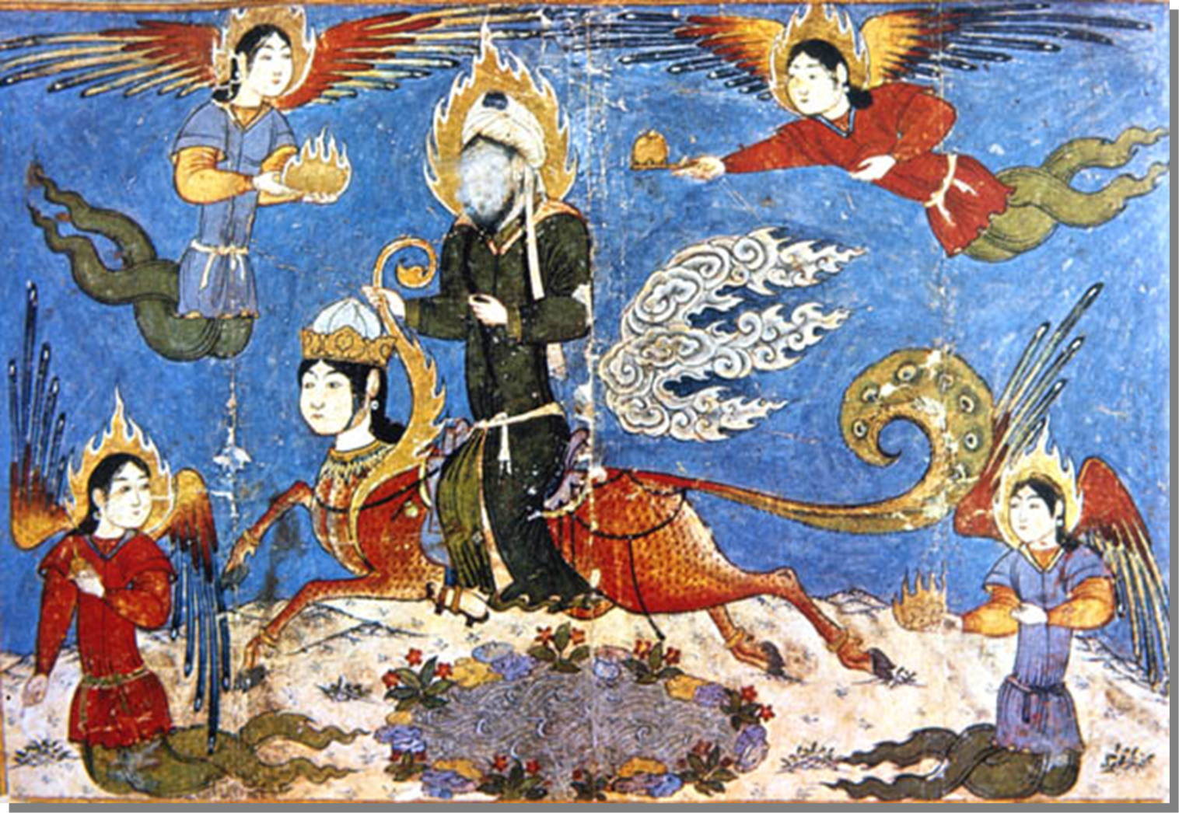
Night Journey of the Prophet fourteenth century Timurid miniature))
Notes:
אלבראק מתואר אצל אבן אסחאק (מאה 8).

Slide 30
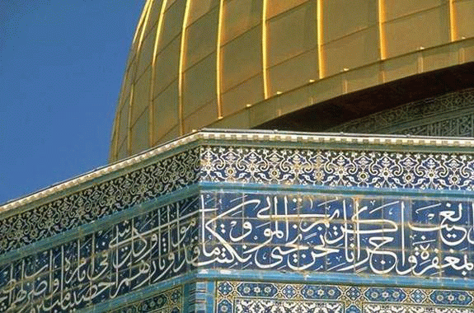
Outer Inscription (renewed)

Slide 31
Ayyubid Period
27 Rajab(!) 583 / 1187 capitulation of Frankish Jerusalem; re-Islamization, fortification, Islamization of narratives
September 1192 Treaty of Jaffa: truce between Saladin and Richard Lion Heart.
1229 treaty between al-Malik al-Kamil and Frederick II - Jerusalem temporarily restored to Franks; Temple Mt. remains Muslim. Public outrage on Muslim side; excommunication of Emperor on Christian side.
Resurgence of Fada’il works
Notes:
Saladin allows Christians to ransom themselves and leave.
Marked elevation in status of Jerusalem for Muslims. flies in the faces of pragmatic Ayyubids in 1229

Slide 32
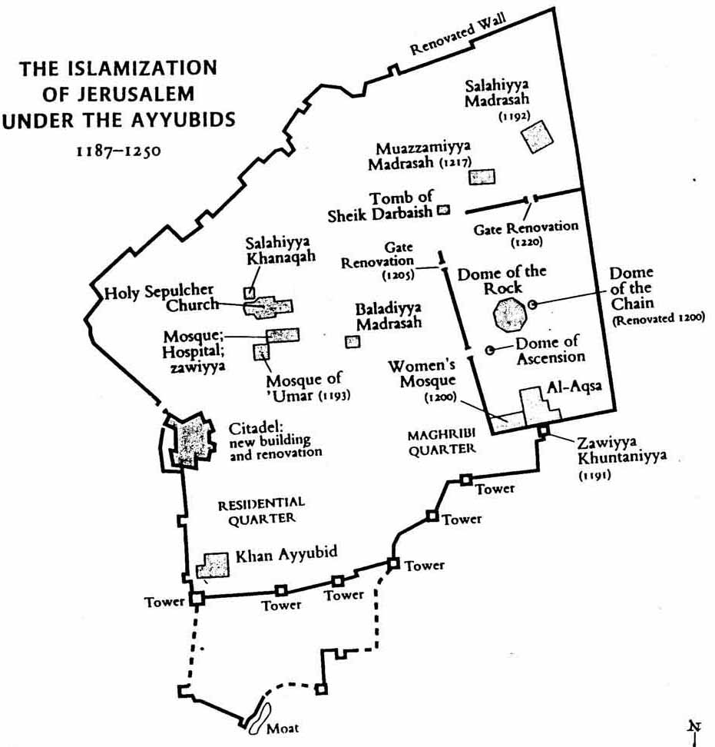
Notes:
Re-Islamization! Crosses taken off Temple Mt, sent to Baghdad, reconsecration of buildings. Holy Sepulchre unharmed (Saladin remembers Umar I) but Christian pilgrimage banned until 1192 and renewed under humiliating conditions. Endowment of madaris, sufi centers and mosques. Fortifications. Use of architectural spolia

Slide 33
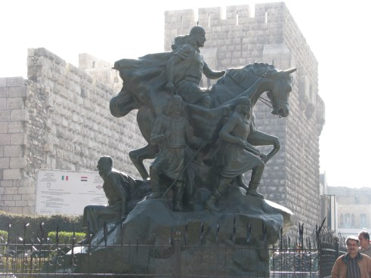
Saladin (Damascus 1992) "Jerusalem’s Liberation” in three languages
Notes:
Erected on 800th anniversary of his death. Perhaps greatest and most popular Arab/Syrian/Egyptian/ Kurdish/all-Islamic hero. Chivalrous, soft-hearted and devout. Portrayed with 3 commanders and captive Frankish kings.

Slide 34
Ayyubid Building Projects
Re-consecration of Haram, reparations; commemorational structures on the Haram
use of architectural spolia
Conversion of Latin buildings to madrasas and Sufi establishments;
Naskhi script
Fortifications (walls, citadel)

Slide 35
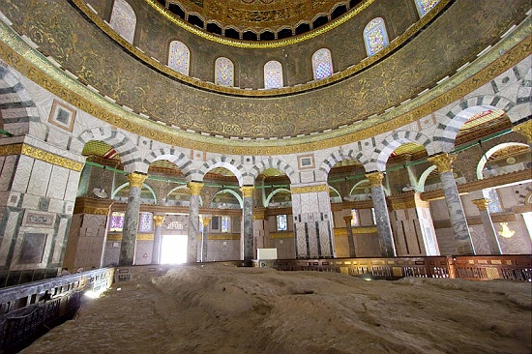
Interior of Dome of the Rock

Slide 36
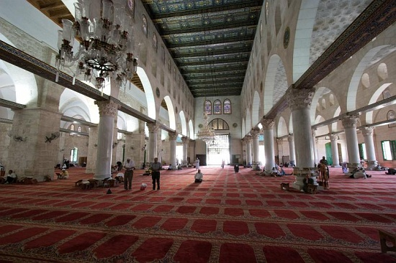
Interior of al-Aqsa

Slide 37
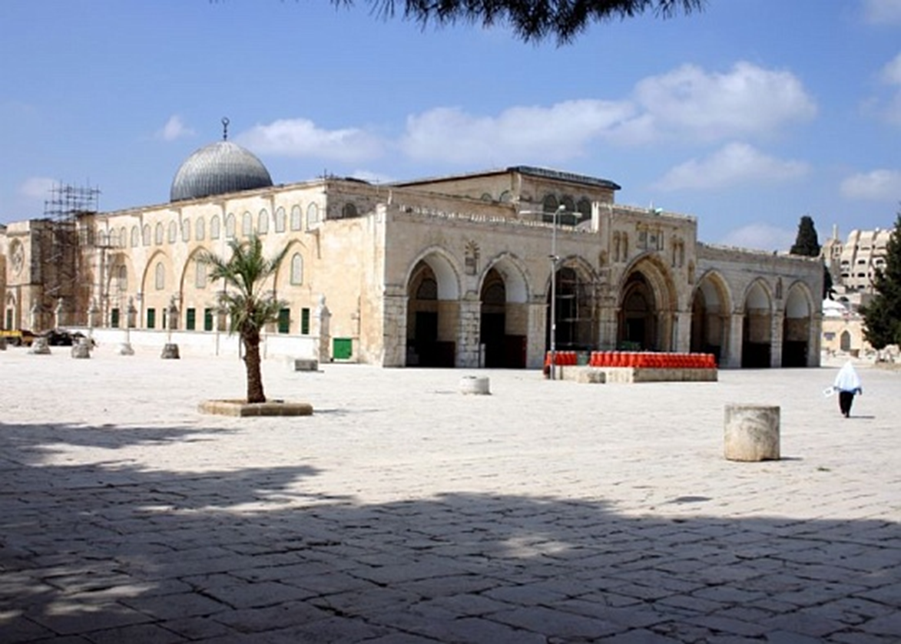
Al-Aqsa, Ayyubid facade
Notes:
Front added by Ayyubids

Slide 38
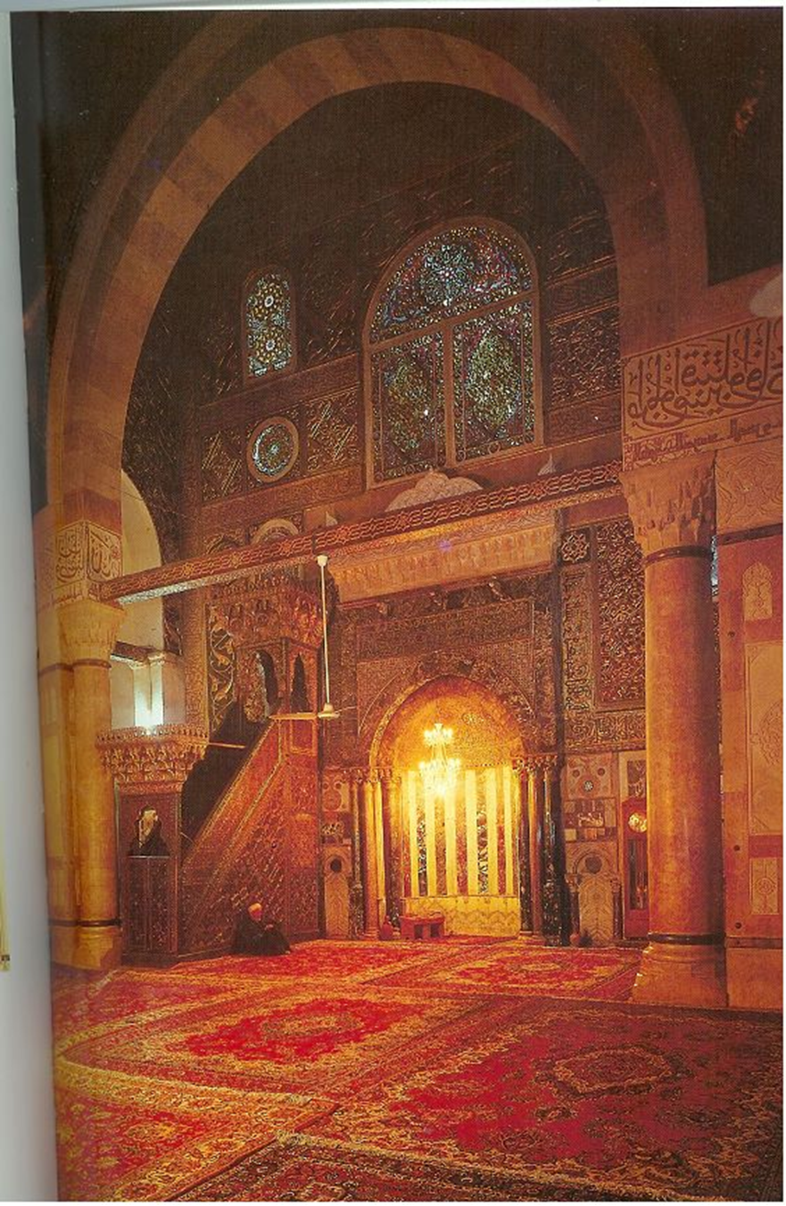
Nur al-Din’s minbar
Commissioned in 1168-9, installed in 1187

Slide 39
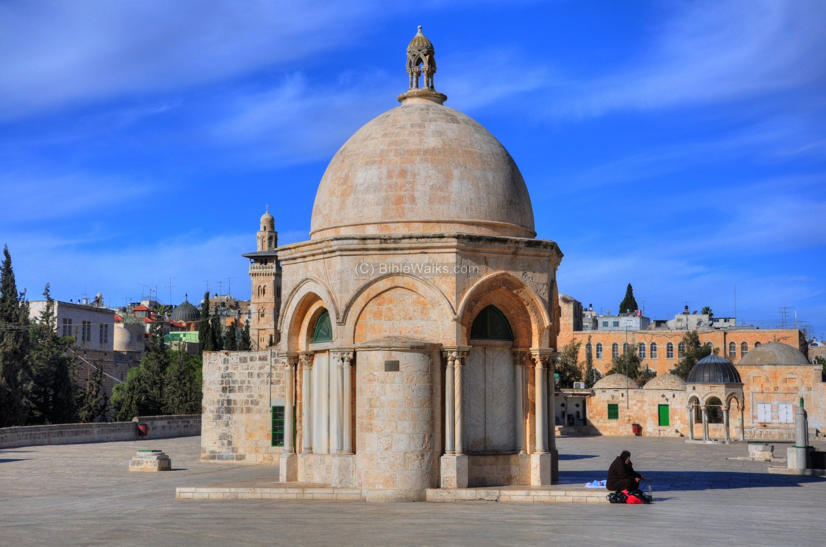
Dome of the Acension (Qubbat al-Mi`raj)
Notes:
Crusader chapel with added mihrab

Slide 40
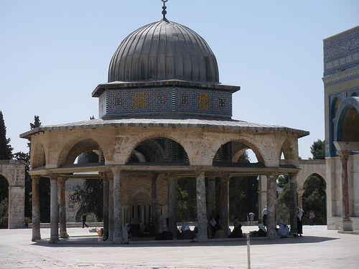
Qubbat al-Silsila/ St. James CHapel

Slide 41
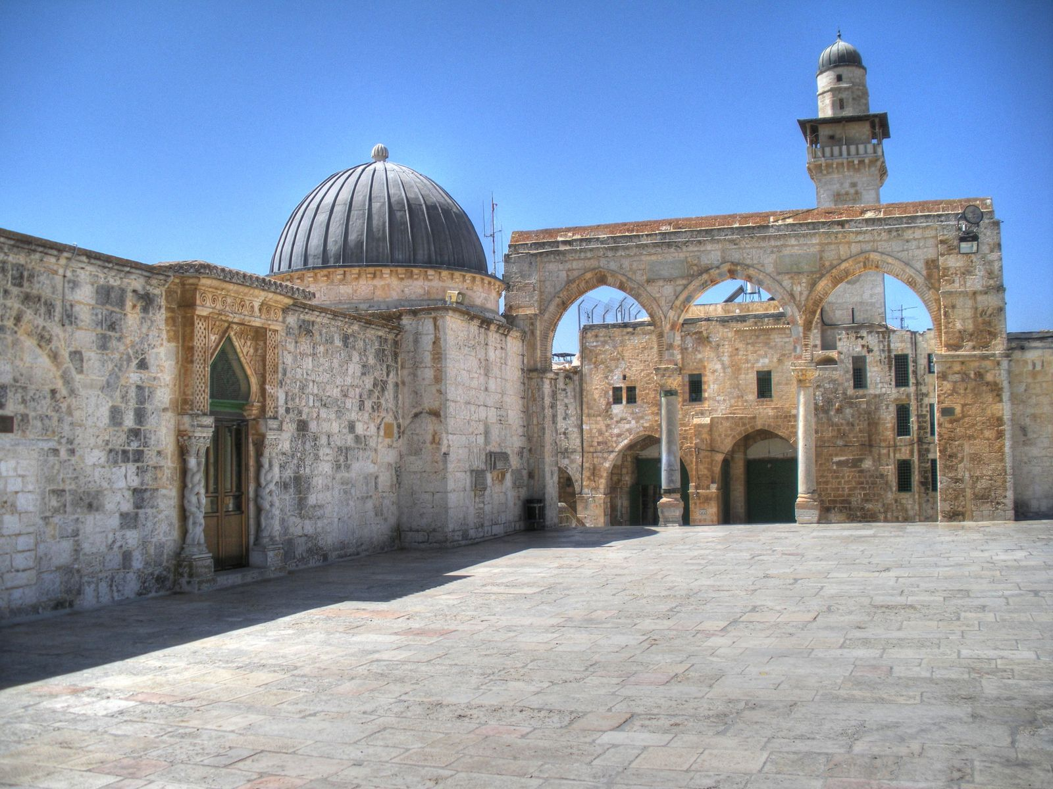
Al-Madrasa al-Nahawiyya, 1208 (“Grammar school”)
Notes:
Mu`azzam `Isa – Saladin nephew. Sultan interested in theology, Arabic and science. Endowed for 25 Hanafi students of grammar. Note columns (spolia).

Slide 42
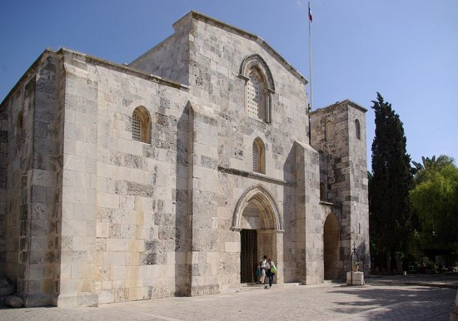
Santa Anna / al-Madrasa al-Salahiyya (1192)
Notes:
Endowed by Saladin for Shaifi students of law. Off the esplanade (by Lion’s Gate)

Slide 43
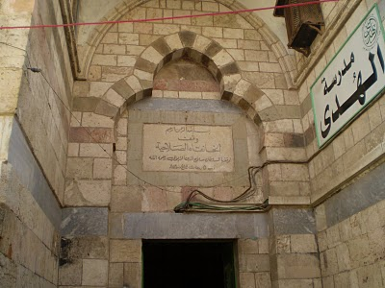
Al-Khanqah al-Salahiyya (Patriarch’s Palace turned in Sufi lodge)
Notes:
On Via Dolorasa

Slide 44
Jewish resettlement 1187-1219 (1229)
Great (and/or messianic) expectation from Saladin
Refugees from Ascalon (1191)
Maghrebis, Yemenites, French (“300 Rabbis”)
Influence of Sufism and Christian pilgrimage?
Support of Abraham Maimonides head of Egyptian Jewry
Notes:
Saladin likened to Coresh, though no evidence of proclamation.

Slide 46
Re-abandonment
Economic hardships, better opportunities in Crusader Acre, Bilbays, Alexandria
Demolition of walls (1219)
Peace agreement between al-Malik al-Kamil and Frederich II (1229) and restoration of Jerusalem to the Crusaders
One Jewish dyer settles in the city

Slide 47
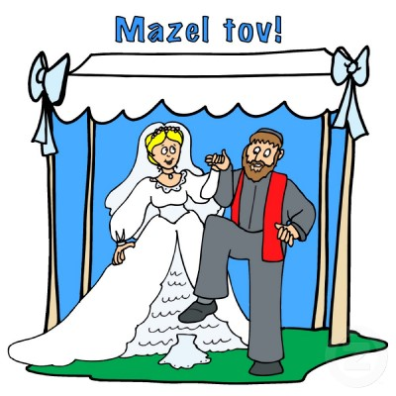
“if I forget thee, Oh Jerusalem, may my right hand wither…”
Notes:
Yet continuous spiritual attachment

Slide 48
Ramadan in Jerusalem
Pictures taken in June 2015

Slide 49
Masharti – waking the people up for breakfast before dawn
אחמד מחמוד ומורן טל

Slide 50
Breaking the fast after sunset
אחמד מחמוד ומורן טל

Slide 51
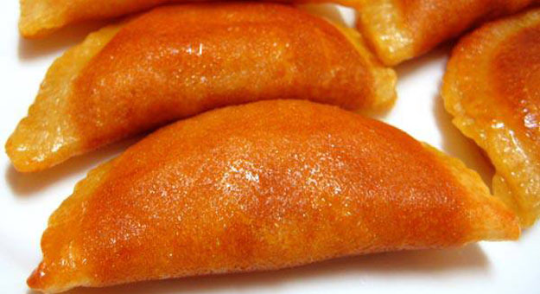
Special sweets
מאכלים וקינוחים מיוחדים
אחמד מחמוד ומורן טל

Slide 52
Nocturnal Prayers (tarawikh)
אחמד מחמוד ומורן טל

Slide 53
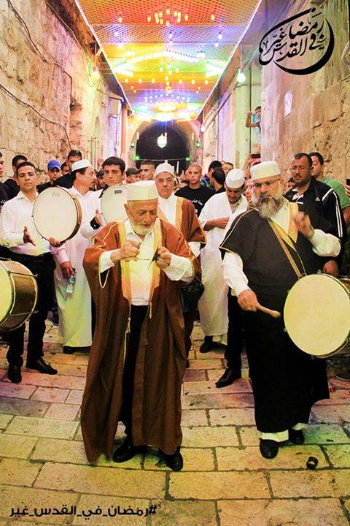
Sufi Performance
אחמד מחמוד ומורן טל

Slide 54
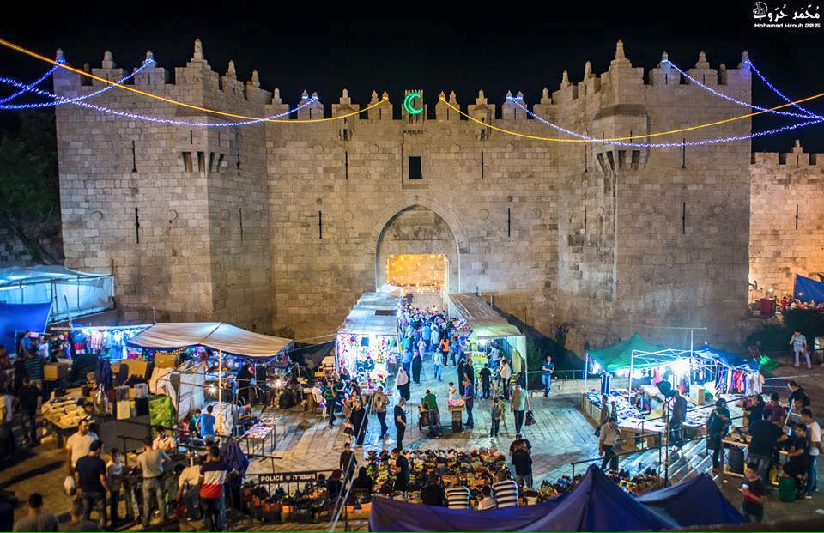
Night of Ramadan
אחמד מחמוד ומורן טל

Slide 55
אחמד מחמוד ומורן טל

